Slide 1


Cultural Social Innovation Guide
www.csi-project.eu

Slide 2

Cultural Social Innovation Guide
Cultural Social Innovation Europe –
Erasmus+ Project Partnership
1st edition in English language | July 2022
Intellectual property rights:
Copyright © 2022 Cultural Social Innovation Europe - Erasmus+ Project Partnership
www.csi-project.eu
Except where otherwise noted, the content of this Guide is published under the terms of the Creative Commons Attribution - ShareAlike 4.0 license.
To read a summary of this license, visit the website: https://creativecommons.org/licenses/by-sa/4.0/
Disclaimer:
The European Commission's support for the production of this publication does not constitute an endorsement of the contents, which reflect the views only of the authors, and the Commission cannot be held responsible for any use which may be made of the information contained therein.
Write the Names of the staff members who contributed to this Guide.

Slide 3
Table of contents
List of Abbreviations
Preface
Background
Methodology
Presentation and analysis of results
4.1. Presentation and analysis of the outcomes of the desk research
4.1.1. Definition of Cultural Social Innovation
4.1.2. Supporting policies on cultural social innovation
4.1.3. Legislation and taxation
4.1.4. Ongoing movements
4.2. Presentation and analysis of the outcomes of the field research
4.2.1. Hungary
4.2.2. Greece
4.2.3. Denmark
4.2.4. Ireland
4.2.5. Italy
4.2.6. The UK
The Cultural Social Innovation Framework
5.1. The structure and content of theFramework
5.2. Uses of the Framework for CSI
Annexes
1. The project partners
2. Countries overview: Similarities and Differences
3. Desk and field research template
Resources
References
01
02
03
04
05

Slide 4
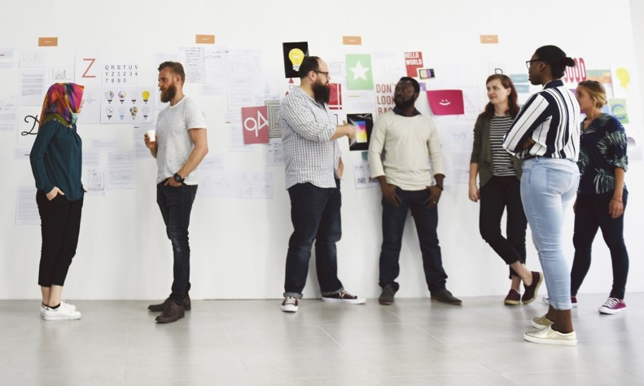
LIST OF ABBREVIATIONS
BoWB: Biennale of Western Balkans http://bowb.org/
CARE principles: Collective benefit, Authority to control, Responsibility, Ethics https://www.gida-global.org/care
CCAG: Castlerea Community Arts Group
CCI: Culture and Creative Industries
CSI: Cultural Social Innovation
CSI EU: Cultural Social Innovation Europe Erasmus+ project https://www.csi-project.eu/
CSR: Corporate Social Responsibility
ECOC: European Capital of Culture
FAIR principles: Findable, Accessible, Interoperable, Reusable https://www.go-fair.org/fair-principles/
IAC: IAC Centro Arti Integrate - Societa Cooperativa di Produzione e Lavoro
NAE: New Arts Exchange
PABR: Participatory Art Based Research
PPP: Public Private Partnership
R&D: Resarch and Development
SME: Small-Medium Enterprise
UKYA: UK Young Artists
VOC: Voluntary Open Culture 2019
VSP: Victoria Square Project http://victoriasquareproject.gr/

Slide 5
01
Preface

Slide 6

01
PREFACE
This Cultural Social Innovation Guide was created within the framework of the Erasmus+ project “CSI EU: Cultural Social Innovation Europe” (www.csi-project.eu) in order to map various case studies of cultural social innovation in Denmark, Greece, Hungary, Italy, Ireland, and the UK, with the aim to:
raise awareness and commitment to introducing Cultural
Social Innovation (CSI) into the education of adults and young people, and
to inspire and cultivate the creativity skills that are essential in the
culture-based social innovation process, aided with the use of digital tools.
Ireland
Denmark
UK
Hungary
Italy
Greece
While the COVID-19 pandemic spread fear, anxiety and economic downturn across the world, it also heralded a new era of innovations, with culture-based social innovation offering a silver lining for the strengthening of local economies and wellbeing.
The CSI EU project explores ways to learn from and build on that experience by engaging young adults to come together:
to develop social innovation projects in the cultural, arts and creative spaces for the development of their personal and professional life, as well as for the well-being of their local communities; and
to help build solidarity, resilience and improved mental health in the face of unprecedented times.

Slide 7

The project focuses on identifying and promoting the term Cultural Social Innovation (CSI) and its use as a response to the vulnerabilities put in the forefront during the current pandemic, as well as a valuable tool to cope with the negative impact of COVID-19 on people’s lives. Specifically, it aims to empower adults and young people most affected by COVID-19 to become confident cultural social innovators, and design innovative (digital) solutions to challenges posed by the crisis.
More concretely, the specific objectives of CSI EU are to:
increase awareness and commitment to CSI at all levels in the adult education and youth sector by evidencing its contribution to empowerment, integration and competence development;
strengthen the capacity of adult and youth organisations to teach CSI by improving the knowledge and digital skills of adult and youth educators, and by providing practical resources to teach CSI in non-formal contexts; and
maximize the number of adults and young people learning and carrying out CSI projects.
THIS GUIDE IS FOR:
01
adults and young people, with lower skills, especially those at risk, who need to strengthen key competences and engage more fully with society around them;
adults and youth educators who need to understand the role of CSI, and increase their own capacity in teaching it through innovative pedagogical approaches; and
organisations from the cultural and creative sectors that need new ways to engage with other sectors and local communities with the aim to become more resilient in the current time of economic uncertainty, ensuring the sustainable development of cultural and arts sectors across Europe.
02
03

Slide 8

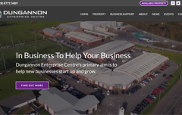
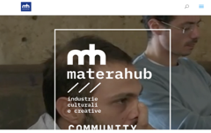
Dungannon Enterprise Centre
Dungannon Enterprise Centre has a clear focus on the development of the creative and innovative business sector across its region and throughout Northern Ireland. DEC provides leading training and advisory support to enable the creation of new creative businesses in this sector. CSI: EU complements and builds upon E+ “Youth Enterprise Through Arts” which integrated entrepreneurship training among young people in the fields of creative and digital arts, with the aim of encouraging young people to set up their own private or community arts related business.
CLICK TO VIEW
CSI EU stems from the consortium’s belief that public policy and investment in adults and young people should contribute to more culturally-sensitive and engaged citizens and consequently to better employees. The key differentiating feature of CSI EU is to present innovation as a transversal skill and a mindset which empowers adults to identify and creatively solve social problems by designing sustainable initiatives, all the while it contributes to the development of culturally empathetic and active citizens. Innovation, imagination and resilience are key features that will help people with lower skills and/or directly affected by the COVID-19 crisis to rebound and exploit new opportunities, and take advantage of the power of the cultural and arts sectors to emerge stronger with more relevant skills through innovative or/and digital methods.
For this reason, the CSI EU project brought together organisations specialised in the fields of adult learning, arts and culture to work together and develop social innovation projects with young adults in cultural and creative spaces, as well as to encourage adult educators to adopt creative and innovative approaches to education, reconceptualise issues and deliver more relevant learning pathways to young adults in this time of economic and societal upheaval.
The project consortium consists of the following organisations, each one with a complementary expertise for a valuable contribution to the aims and objectives of this Guide. The fields of expertise that the consortium is specialised in are: culture and creativity, social innovation, pedagogy focus and young adults focus
Materahub
More concretely, in the creative and culture-based organisations field, Materahub is an Italian creative consortium with a broad scope of networks in the creative and cultural sectors, that helps cultural and arts’ initiatives to grow. While working directly with adults in the creative industries, it increasingly accompanies all types of organisations to boost the creative and cultural components of their work;
CLICK TO VIEW

Slide 9
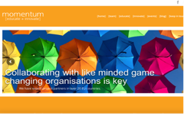
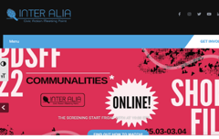
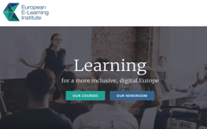
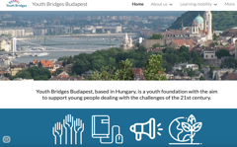
MOMENTUM
CLICK TO VIEW
MOMENTUM is one of Ireland’s leading creative economy and cluster development specialists, and a nationally accredited training organisation that specializes in innovative approaches to learning and social inclusion development.
Winston Churchill
Inter Alia
In the field of social innovation, Inter Alia is an experienced provider of social innovation with a creative and cultural dimension throughout Greece, promoting and enhancing civic action and society’s interconnectedness and effectiveness in influencing decision-making at any level, in addition to empowering young adults to increase their employment opportunities through training, skills development, civic participation and innovation.
CLICK TO VIEW
EUEI
CLICK TO VIEW
EUEI holds the pedagogy focus, being specialized in immersive and online educational environments. Its commitment to user-friendliness, mobile/tablet friendly platforms (while not compromising on pedagogical expertise) is vital to achieving learning outcomes for our target groups. Lastly,
YOUTH BRIDGES
CLICK TO VIEW
Lastly, YOUTH BRIDGES (HU) is a non-profit organisation which helps young adults develop the transversal skills they need at an early stage of their careers through training, exchanges and service/volunteering projects. Its focus on intercultural communication and professional skills complements the expertise of the other project partners, and its continual contact with hundreds of young people and specific knowledge of youth needs in Central and Eastern Europe balances the project generationally and geographically. ¹
Adhering to the consortium’s expertise, we aimed to map a variety of understandings and definitions of the term “Cultural Social Innovation” (CSI); illustrate CSI in action; take into consideration skills gaps in current adult and youth education provision; and include CSI’s relationship to key competences. Therefore we hope that the following chapters will be valuable for the readers we are addressing and beyond.
¹ To read a detailed presentation of the partners, see Annex: The project partners.

Slide 10
02
Background

Slide 11
“
“As we overcome the pandemic, as we prepare necessary reforms and as we speed up the twin green and digital transitions, I believe it is time to also adapt the social rulebook. A rulebook which ensures solidarity between generations. A rulebook that rewards entrepreneurs who take care of their employees. Which focuses on jobs and opens up opportunities. Which puts skills, innovation and social protection on an equal footing”,
said the Commission President von der Leyen at her speech to the European Parliament, on the 20th of January 2021. ²
Developing further on this, we are in an era when Europe and the world face fundamental challenges at social, economic and political levels, especially during and towards the post-pandemic period. According to our project’s consortium, the COVID-19 pandemic has exposed the vulnerabilities of lower skilled adults and young people by exacerbating the digital divide. Strategically, the pandemic has impacted career opportunities and mental health, accelerating the imperative need to provide adults and young people with “skills to improve and adapt” in a rapidly changing environment. In addition, the cultural sector is recognised as a place where social, community and digital innovations take place. To this end, we believe that social innovation can offer a new pathway and has been advanced intensively by the creative and cultural industries.
Given the above, it is also important to pinpoint that the European Commission has also put an emphasis on the importance of social innovation as a tool to empower society in order to recover from the effects of the pandemic, but also to offer solutions to the current social challenges. Broadly speaking, the Commission has defined social innovation as “the development of new ideas, services and models to better address social issues. Social innovation invites input from public and private actors, including civil society, to improve social services”. ³ In this context, the European Pillar of Social Rights (2017) and the statement of the Commission President, von der Leyen, become more than relevant in the discussion of how social innovation could become the driving force to achieve the EU's leading strategy, Europe 2020, which aims at a smart, sustainable and inclusive economy. ⁴
² quoted in: European Commission, The European Pillar of Social Rights Action Plan, https://op.europa.eu/webpub/empl/european-pillar-of-social-rights/en/ (reached 21/12/2021)
³ European Commission, Employment, Social Affairs & Inclusion, Social Innovation, https://ec.europa.eu/social/main.jsp?catId=1022 (reached 21/12/2021)
⁴ European Commission, Guide to Social Innovation, Regional and Urban Policy, February 2013, p.10

Slide 12

Moreover, the Europe 2020 strategy presents social innovation as the key concept to attain its targets. In the flagship initiatives “Innovation Union10'', "European Platform Against Poverty", "A Digital Agenda for Europe" and the "Active and Healthy Ageing" innovation partnership, social innovation figures prominently.⁵ In fact, according to the Guide to Social Innovation, published in 2017, social innovation is “the development and implementation of new ideas (products, services and models) to meet social needs and create new social relationships or collaborations. It represents new responses to pressing social demands, which affect the process of social interactions. It is aimed at improving human well-being. Social innovations are innovations that are social in both their ends and their means. They are innovations that are not only good for society, but also enhance individuals’ capacity to act”. ⁶
All the while, going thoroughly through the report “Annual State of the Union Report” (funded under the EC H2020 project “Social Innovation Community”), it becomes clear that EU policy provides a framework for social innovation; there are key employment policy strategies and initiatives that refer explicitly to social innovation, as well as more broadly recognising innovation in both processes and governance as a crucial factor in achieving policy goals. ⁷
⁵ Sophie Reynolds (Nesta), Madeleine Gabriel (Nesta), Charlotte Heales (Young Foundation), D5.3: Annual State of the Union Report – Part 1, Social innovation policy in Europe: where next?, 2017
⁶ European Commission (2013). Guide to Social Innovation. Brussels: Regional and Urban
Policy Publications, Office of the European Union, D5.3: Annual State of the Union Report – Part 1, Social innovation policy in Europe: where next?, Sophie Reynolds (Nesta), Madeleine Gabriel (Nesta), Charlotte Heales (The Young Foundation), 2017, p.23
⁷ Nabeela Ahmed (The Young Foundation), Sophie Reynolds (Nesta), Isaac Stanley (Nesta), Sandra Gulyurtlu (The Young Foundation), Madeleine Gabriel (Nesta), D5.6 Annual State of the Union Report - Part II, How is EU employment policy driving social innovation? p.22

Slide 13

In 2007, the European Commission proposed a European Agenda for Culture, which attempted to respond to the challenges of globalisation.
ITS OBJECTIVES WERE BUILT AROUND THREE PRIORITIES:
01
cultural diversity and intercultural dialogue;
stimulation of creativity within the framework of the Lisbon Strategy for growth and jobs;
and culture as a vital element in international relations.
02
03
A report on the implementation of the aforementioned agenda was presented by the European Commission to the European Parliament, the Council, the European Economic and Social Committee and the Committee of the Regions on the 19th July 2010. According to this, a variety of actions were taken in order to promote culture as a catalyst for creativity; among them, the 2009 European Year of Creativity and Innovation, which examined how culture may generate economic and social innovation; studies on the impact of culture on creativity, on entrepreneurship in cultural and creative industries and on the contribution of culture to local and regional development; the 2010 Green Paper on the unlocking of the potential of cultural and creative industries. ⁸
⁸ Eur-Lex, European agenda for culture in a globalising world, https://eur-lex.europa.eu/legal-content/EN/TXT/?uri=LEGISSUM%3Al29019

Slide 14

In 2010, the European Commission issued the Green Paper, the first ever EC paper on Culture and Creative Industries (CCI). The economic and social importance of the sector, as well as its contribution to the Europe 2020 strategy is officially acknowledged along with some of its flagship initiatives such as the Innovation Union, the Digital Agenda, the Agenda for new skills and new jobs or an industrial policy for the globalisation era. President Barroso, in his Political Guidelines for the next Commission, had expressed that “if Europe wants to remain competitive in this changing global environment, it needs to put in place the right conditions for creativity and innovation to flourish in a new entrepreneurial culture”.⁹ According to the Green Paper, CCIs are important drivers of economic and social innovation in many other sectors, all the while, they can play a major role in equipping European citizens with the creative, entrepreneurial and intercultural skills they need.
The 2007 European Agenda for Culture was renewed and adopted in 2018. The New Agenda¹⁰ provides the framework for cooperation on culture at the EU level, focusing on the positive contribution that culture brings to Europe’s society, economy and international relations. The New Agenda consists of three strategic areas, with specific objectives corresponding to social, economic and external dimensions. In general, we could say that the New Agenda supports culture as an engine for sustainable social and economic development.¹¹
Given the above, we believe that social innovation can be a tool to address the current growing social needs, to mobilize local actors and provide answers to complex socio-cultural challenges of our times. To address these challenges, we believe that we have to involve small-scale creative actors to share and adopt the diverse innovation being developed in their environment .
⁹ European Commission, Green Paper - Unlocking the potential of cultural and creative industries, 2010 https://op.europa.eu/en/publication-detail/-/publication/1cb6f484-074b-4913-87b3-344ccf020eef/language-en
¹⁰ A New European Agenda for Culture - SWD(2018) 267 final, https://ec.europa.eu/culture/document/new-european-agenda-culture-swd2018-267-final
¹¹ European Commission, Strategic framework for the EU's cultural policy, https://ec.europa.eu/culture/policies/strategic-framework-for-the-eus-cultural-policy

Slide 15
03
Methodology

Slide 16
03
METHODOLOGY
As stated in the introductory remarks, the main goal of the CSI EU project is to introduce cultural social innovation into the education of young people and adults, in order to develop their transversal, digital and employability skills, and hence, to become confident cultural social innovators, and design innovative (digital) solutions to challenges posed by the COVID-19 pandemic. In order to achieve this goal, and for preparing this Guide, we deemed useful and necessary:
to explore the concept of cultural social innovation itself, and the EU and national policies that promote it;
to map exemplary projects and initiatives of cultural social innovation; and
to identify the skills needed in culture-based social innovation processes

Slide 17
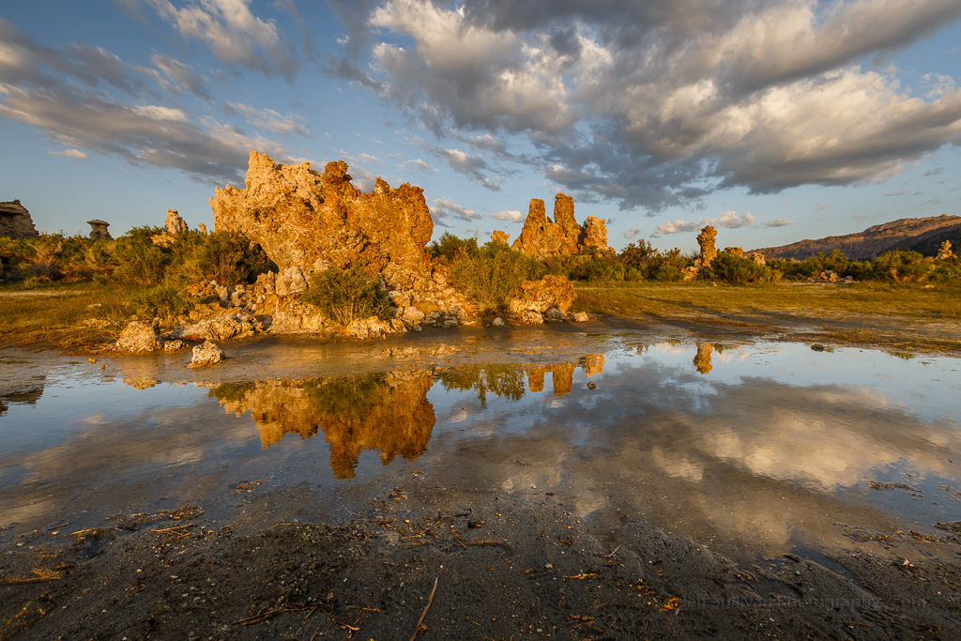
Italy
Denmark
Hungary
Greece
Ireland
UK
We also deemed useful and necessary to adopt a comparative approach, and combine different research methods and techniques in order to collect related information from the 6 national contexts of the project partnership: Italy, Denmark, Hungary, Greece, Ireland and the UK. In specific:
Regarding the concept of cultural social innovation and the policies for its promotion, we carried out a desk research undertaken by each partner of the consortium at national level. This desk research, which took place from September to November 2021, focused on information about: (a) the existence of relevant definitions, supporting policies, legislation and taxation; and (b) any ongoing movements and initiatives related to the topic. In addition, we examined academic journals and publications, as well as policy and practice documents and recommendations. In this process, we also set common qualitative and quantitative criteria, in order to analyse the results, and pinpoint any similarities and differences among the socio-cultural backgrounds and national contexts of the project partnership.
Since our purpose was to study cultural social innovation from both a top-down and bottom-up perspective, we opted out for case studies demonstrating the potential of cultural social innovation among young people and adults. From September to December 2021, we conducted (number) in-depth interviews with representatives of organisations and non-formal initiatives which -at that time- were active at a national level — and these interviews allowed us, on one hand, to investigate and highlight their ideas, conceptualisations, sustainability plans and innovative elements, and on the other, to collect personal views and experiences around the topic of cultural social innovation.
Last but not least, from November 2021 to January 2022, we conducted an online survey via a Google Form (link to view-only mode) in order to explore which skills are needed for young people and adults to become cultural social innovators. This online survey, which was widely distributed by the online communication channels of all project partners, was based on 3 key competence frameworks, which have been developed by the European Commission, and identify the core competencies needed nowadays in the professional and personal lives of the EU citizens.
Mono Lake Golden Hour Reflection" by Jeff Sullivan (www.JeffSullivanPhotography.com) is licensed under CC BY-NC-ND 2.0

Slide 18




These 3 frameworks are:
the EntreComp (https://ec.europa.eu/jrc/en/entrecomp), which includes 15 competences in 3 key areas that describe what it means to be entrepreneurial;
the DigComp (https://ec.europa.eu/jrc/en/digcomp), which includes 21 competences needed to use digital technologies in a confident and safe way for various purposes; and
the LifeComp (https://ec.europa.eu/jrc/en/lifecomp), which sets out a core set of 9 skills for personal development, social inclusion, active citizenship, and employment. We received 16 responses, most of which were provided by adult and youth educators (62,5%) and social entrepreneurs / managers (18,8%).
We received 16 responses, most of which were provided by adult and youth educators (62,5%) and social entrepreneurs / managers (18,8%).
Through the comparative analysis and presentation of the information we gathered with the use of the above-mentioned research methods and techniques, we aspire to share with you -the readers of this Guide- approaches, methods, challenges and opportunities for CSI education and entrepreneurship. Of course, the comparative approach we have adopted cannot lead us to authoritative definitions and methods of cultural social innovation, nor to generalisations regarding the ongoing challenges and opportunities, and the skills needed to tackle or take advantage of them respectively. However, it offers us the possibility to trace the similarities and differences among the 6 national contexts of the project partnership, as well as to highlight the unique characteristics of specific case studies. Also, it can help us understand different processes and outcomes, and their influence and importance in present-day culture-based social innovation initiatives.
A Game Of Tones" by Thomas Paal Photography is licensed under CC BY-NC-SA 2.0

Slide 19
04
Presentation and analysis of results

Slide 20

04
PRESENTATION AND ANALYSIS OF RESULTS
4.1. Presentation and analysis of the outcomes of the desk research
4.1.1. Definition of Cultural Social Innovation
The investigation of an existing definition in each national context was the basis for the desk research to continue. The outcome was common in all countries; such a definition of this threefold terminology does not exist. However the concept of social innovation and its definition was pinpointed as an issue to explore in all the countries’ desk research. The results showed that there is no uniformly accepted definition in the majority of the countries, even though there were cases where a definition was provided. More concretely, Denmark, Greece, Hungary and Ireland agree that such a definition is not existing at a national level, whereas Italy and UK provided with a definition which is widely accepted in their national setting.
Hungary
In particular, according to the desk research in Hungary , conceptual approaches to social innovation are different, and currently there is no uniformly accepted definition. Most often, social innovation is interpreted as follows: “Social innovation provides new or novel answers to a community’s problems with the goal of increasing the well-being of the community” (Kocizicszky et al. 2017).
Perhaps each country could get its own mini heading? In the finla design we could use pictures of each counties national flag.
A broader definition, according to National Laboratory for Social Innovation argues that: Social innovation is the development and implementation of new ideas (products, services, processes) that:
aim at improving well-being and quality of life;
respond to social needs;
create new social relations and cooperation;
are innovations that not only benefit society, but also strengthen the active participation of citizens.

Slide 21

The terms
“social economy”,
“social entrepreneurship”,
“social services” and
“social innovation”
are not clearly distinguished. Social innovation and social entrepreneurship are strongly interlinked, having a complementary and an important role to play in tackling major societal challenges in Hungary, such as poverty and social exclusion, aging population, youth unemployment and too early exit of 55+ year old, discrimination against Roma and homelessness.
In Hungary, the concept of social innovation is mainly connected with topics, such as environmental protection, sustainability, rural development, education, and employability of economically or socially disadvantaged groups (Kiss-Mihály, 2016). Cultural Social Innovation is not defined, and, in addition to that, initiatives from the field of culture and creativity are less considered as social innovations. On the other hand, CSIs with strong community-development factors can be the part of this discourse, and some would refer to 'culture-based local development' or 'culture-based local economic development' (mainly in rural areas) (Nemes-Varga, 2015).

Slide 22

Greece
In the case of Greece, a definition of social cultural innovation does not exist either. Social innovation is tightly linked with social enterprises, all the while, when the discussion comes to cultural innovation, we see that culture is the vehicle in order to create social innovation. In Greece, there is a definition of innovation from the Ministry of Development and Investments (in particular the European Structural and Investment Funds) according to which the term innovation defines both a process and its outcome. It is the transformation of an idea into a marketable product or service, a -newly improved- functional method of production or distribution, or even a new method of providing social services. The term also covers social, institutional and organisational innovation, including service innovation.¹²
In continuation, going further to define social innovation, there is a Greek Law from 2016 that defines it as “the production of products and the provision of services, which aim at meeting social needs, reconciling production and consumption, harmonizing supply and demand and the formation of a new type of social relations based on collectivity and parity and not on competition”.¹³ From 2016 to 2019, the Horizon 2020 Programme titled “Social Innovation Community” aimed at demonstrating a variety of views on what social innovation means to different kinds of organisations in Greece (as well as in other European countries). According to this research:
“
“Social innovation and social economy in Greece are relatively new concepts mainly associated with what is known as ‘Solidarity Economy’.
While in other European countries discussions related to social innovation have taken place for almost 30 years now, in Greece, organized forms of social ventures are apparent for only about 10 years, though in an experimental stage. It was especially due to the economic crisis that heavily hit Greece that has led to social innovation becoming a necessity.” ¹⁴
¹² https://www.espa.gr/el/Pages/DictionaryFS.aspx?item=268
¹³ https://www.elinyae.gr/ethniki-nomothesia/n-44302016-fek-205a-31102016
¹⁴ https://www.siceurope.eu/countries/greece/profile

Slide 23
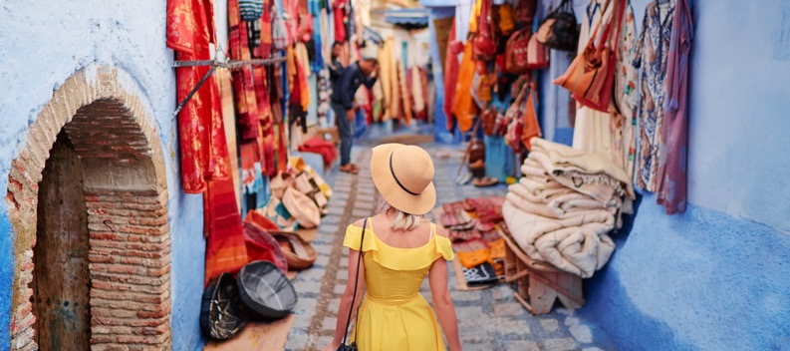

This is the reason why we looked further in the Greek Laws, and we found that, indeed, that before the articulation of the definition of social innovation, there was a definition of Social and Solidarity Economy defined as the set of economic activities based on an alternative form of organisation of relations of production, distribution, consumption and reinvestment, based on the principles of democracy, equality, solidarity, cooperation, and respect for the humankind and the environment. ¹⁵
Denmark
The desk research in Denmark showed that, in spite of the increased interest, there is no shared and mutually accepted definition of social innovation at national level similar with the term of cultural social innovation. Denmark is famous for its large and inclusive welfare system. In Denmark, where institutions generally function well, and where everyone receives the same amount and level of services, social innovation is a lot more about supplementing or improving existing public sector-led initiatives. The need for social innovation arises as the Danish welfare system is beginning to have problems with providing a satisfactory level of support for its citizens due to its aging population. Furthermore, the Danish welfare state might be one of the best in the world in terms of providing food on the table, clothes and roof over the head for its citizens, but some critics argue that it has been less successful at providing its citizens with a sense of inclusion, purpose, connectedness and belonging. So, whereas material poverty is hard to find in Denmark, social poverty certainly is not.¹⁶
¹⁵ https://www.elinyae.gr/ethniki-nomothesia/n-44302016-fek-205a-31102016
¹⁶ https://www.siceurope.eu/countries/denmark

Slide 24
For Denmark, it is important to understand the political and cultural background in order to obtain an understanding about social innovation. Therefore, social innovation is time- and context-specific which leads to different meanings in different contexts. Therefore, the concept is often being used as a buzzword in many different contexts with very different meanings. For instance, it has been used synonymously with corporate social responsibility (CSR), voluntary work, new welfare technology, and even new forms of social interaction in the workplace.
However, in 2012, TEPSIE, a large-scale European research project, led by the Danish Technological Institute and The Young Foundation, set out to formulate a common definition of social innovation based on an extensive global literature study.¹⁷ The research team arrived at the following definition: “Social innovations are new solutions (products, services, models, markets, processes etc.) that simultaneously meet a social need (more effectively than existing solutions) and lead to new or improved capabilities and relationships and better use of assets and resources. In other words, social innovations are both good for society and enhance society’s capacity to act.” (Young Foundation, 2012).
TEPSIE (”The Theoretical, Empirical and Policy Foundations for Building Social Innovation in Europe”) is a 3-year research project under the European Commission’s 7th Framework Programme, dedicating more than 55.000 man-hours to map European social innovation and analyze key factors and methodologies behind successful social innovation in a number of areas. See more on http://www.tepsie.eu.
Moreover, following in depth research, culture and creativity have long played an important role in the development, inspiration and deployment of social innovation/social enterprises. The legal framework surrounding social enterprise defines it in one of the criteria:
“
“enterprise must have a primary purpose that is beneficial to society with a social, cultural, employment-related, health-related or environmental aim”.
Furthermore, over the years, the third sector has been the source of numerous innovative initiatives to respond to social needs, not least driven by the energy and creativity of the voluntary workforce and the many initiatives stemming from the strong Danish environment of voluntary associations. Likewise, in the informal sector, there is a significant potential for social innovation, given that relationships are informal and based on common interests and mutual trust rather than formal conventions.¹⁸
¹⁷ TEPSIE (”The Theoretical, Empirical and Policy Foundations for Building Social Innovation in Europe”) is a 3-year research project under the European Commission’s 7th Framework Programme, dedicating more than 55.000 man-hours to map European social innovation and analyze key factors and methodologies behind successful social innovation in a number of areas. See more on http://www.tepsie.eu.
¹⁸ Social innovation in Local Government- Experiences from Denmark (Danish Technological Institute) https://www.dti.dk/_/media/65461_Social%20Innovation%20in%20Local%20Government.pdf (pg 5)

Slide 25

Ireland
Ireland also has nothing to offer in terms of definition both for social innovation and cultural social innovation, although the term Cultural Social Innovation is loosely tied in with other terms like “heritage and cultural innovation” and “social and cultural change”. These imply that the term has a link to Ireland’s shared past and traditions (heritage), while also focusing on the potential of the future (change).
Yet, it is worthwhile to mention that Dublin was selected as the city for the first Platform on the Future of Cultural Heritage as it has been particularly active in the field of cultural heritage and social innovation. The city is at the forefront in this area, offering a rich programme of experimentation in this regard. During her Presidency of the EU, Ireland presented herself as a strong supporter of the European Year of Cultural Heritage. Irish people have a strong sense of pride in their local heritage sites. According to a Eurobarometer survey, commissioned by the European Commission, which compares the attitudes of Europeans to cultural heritage, Irish people are more likely to engage in a traditional activity (such as playing music or dancing) compared with EU counterparts. Three specific areas, which are of special relevance in the global agenda of social innovation, and where it was expected that the problem-solving platforms could come up with interesting concrete proposals:
the revitalisation of rural communities;
the crowdsourcing of smart solutions for societal challenges; and
global peace making.

Slide 26


Then Minister for Culture and Heritage, Josepha Madigan, described the platform as a wonderful opportunity to build on and acknowledge our European cultural heritage, and how it has the ability to bring communities together, creating a common understanding for the spaces they share. “Now more than ever, acknowledging and building on our shared European heritage, and the connections it makes between us, is important to us all”.¹⁹
United Kingdom
Things are easier for the cases of the UK and Italy as there is a definition on social innovation as well as for the term “cultural social innovation”. More concretely, for the UK, there is Nesta’s²⁰ inception on what social innovation is according to which innovation can drive economic growth; can be directed to society’s most important problems; and can shape the application of new ideas and technologies in a way that benefits as many people as possible.²¹ In the UK, it seems that the definition provided from the organisation for Economic Cooperation and Development (OECD) has also been adopted, in which social innovation refers to
“
”the design and implementation of new solutions that imply conceptual, process, product, or organisational change, which ultimately aims to improve the welfare and wellbeing of individuals and communities”.²²
¹⁹ Report on the Dublin Platform on 'Heritage and Social Innovation'.pdf (eenca.com)
²⁰ Nest is the UK’s innovation agency for social good, https://www.nesta.org.uk/about-us/
²¹ https://www.nesta.org.uk/innovation-policy/our-work-innovation-policy/
²² https://www.oecd.org/regional/leed/social-innovation.htm

Slide 27


As for the definition of cultural social innovation, just as recently as July 2021, the UK has released a cultural strategy, thus, now making a connection between cultural and social impacts on communities and organisations. By making this connection, it shows that CSI is an ever growing topic. Due to the impact of COVID-19, people are starting to become more creative, with many people starting up creative businesses during lockdowns, when they were out of work, or even just for their own mentality to curb feelings of isolation.
Italy
In Italy, the main definitions regarding social innovation are borrowed from foreign literature. However, in 2014, the Umbria region conducted research to identify some distinctive elements to social innovation cooperatives in the country. Those include the ability to anticipate future needs and to offer new services, in order to organise new and more adequate response systems, the ability to allow entry and operation in new sectors of intervention (social tourism, social agriculture, rehabilitation, social tourism, social agriculture, urban regeneration, renewable energy sources, etc.); the ability to build organisational relationships with different types of subjects (public, private, profit, non-profit); the ability to develop or increase the market orientation of the social cooperative and to overcome traditional patterns of service assignment and delivery; the ability to generate active involvement (not only in the sense of formal participation but also in the form of actual) as a direct contribution in the implementation of the project initiative; the ability to generate positive effects in economic and social terms (positive externalities) towards other actors in the area, thus triggering real local development dynamics; and the ability to create effective conditions for equity and social justice.
In Italy, social innovation appears as a prerogative of social enterprises, especially in the sector of social cooperatives, as they are engaged in maximisation of human and environmental well-being. The effects of the 2008 financial crisis are still being felt in the country, therefore, social innovation has become very central in policy and academic circles. More recognized national and regional funding programmes for social innovation started in 2014.

Slide 28
Italy has a complex political system that is divided in regions. Therefore, funding programmes, policies, and social contexts are often established at territorial and regional levels. Social innovation was long mainly seen in the non-profit sector, but has managed to spread out to public administrations and businesses over the years, and is now recognised as an important policy tool with which to respond to socio-economic changes and new needs. In many areas, there are ongoing experiences, practices and paths of social innovation with which, in recent years, public decision-makers have begun to deal, putting in place policies to support their development at local level. Economic resources originally came from commercial banks and private funds, but since then the State as well as the European Commission have enhanced public fundings.
As far as Cultural Social Innovation is concerned, there is a definition from the Institute Luigi Sturzo:
“
“Generating social innovation with culture means moving from a concept of audience expansion, the so-called audience development, to a concept of creative participation of groups of the population in the process of cultural production”.
The Cultural and Creative Production System is extremely important for the Italian economy. In the country, there is a strong presence of social innovation in the cultural sector. In fact, the majority of Cultural and Creative Industries are somewhat involved in social innovation, most of the time through Public Private Partnerships and participatory initiatives and policies. Since Italy has an extensive number of cultural heritage, classified and non classified, tangible and intangible, social innovation in the cultural sector is often represented by cultural heritage initiatives. The initiatives started in non-profit organisations, but over the past years have been extended to public administrations offering courses on social innovation in the cultural sector, and even policies. The country is currently experiencing a particularly rich period regarding the development of cultural creative activities based largely on social innovation, both in terms of organisation management and relation with territorial development, representing an ideal context in which to explore the emergence of this CSI model.

Slide 29

4.1.2. Supporting policies on cultural social innovation
Investigating the existence of supporting policies on (cultural) social innovation in each national context, we came up with the finding that there are different interpretations of social innovation between countries and cultures. Despite the fact that all the countries of the consortium had to present some policies relevant to our topic under investigation, yet the content and the focus of these policies varied. Greece has mainly adopted policies on cultural social innovation related to the digital transformation of cultural heritage; Denmark is active in creating such policies with a special focus on vulnerable and marginalized groups of people; Hungary has adopted new policies in 2020 aiming to propose a definition and a legislative framework for social innovation; for Ireland, the importance is to build a common understanding of European cultural heritage, and, hence, its policies are moving towards this direction. In specific, the Irish policies focus on advancing innovative proposals for the revitalisation of rural communities, the crowdsourcing of smart solutions for societal challenges and the global peace making. Whereas the Italian policies on social innovation focus in particular on the development of the capacity of public administration on the basis of achievable results. Below, we present all these various policies for each national context.
World through your eyes - Seh´ die Welt mit Deinen Augen" by Daniela Hartmann (alles-schlumpf) is licensed under CC BY-NC-SA 2.0

Slide 30
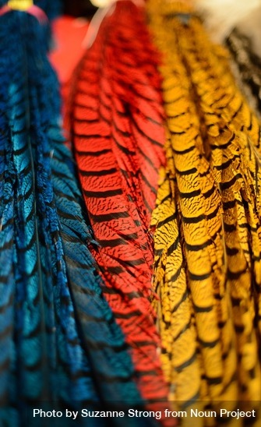
In Hungary, currently, there is no focused framework, legislative or funding background for the development, systemic management of the social innovation environment and the addition of social issues to economic and technological innovation processes. Therefore, the National Laboratory for Social Innovation ("Társadalmi Innovációs Nemzeti Laboratórium'' TINLAB) was established in the fall of 2020 as part of the National Laboratories Programme developed by the National Research, Development and Innovation (NRDI) Office, with the policy support of the Ministry for Innovation and Technology.²³ The knowledge center started its work on the initiative and coordination of Eötvös Loránd University, in a consortium with two other universities and a non-governmental research and knowledge transfer organisation.
One of the main goals of this lab is to propose a definition and legislative framework for social innovation at the national level, and, at the same time, to embed Hungarian social innovation research-and-development and innovation efforts in international cooperation systems. As a first step, a theoretical framework has been developed that includes the possible focus areas of social innovation. The focus areas were divided into several clusters, one of which is culture and creativity. The research is still ongoing, and expected outcomes include policy recommendations.²⁴ Meanwhile, the implementing university consortium has started a pilot training called Social Innovation manager training²⁵ for those graduated experts who are interested in launching, managing and assisting social innovation initiatives, and ready to join a new network of experts.
²³ https://nkfih.gov.hu/for-the-applicants/innovation-ecosystem/national-laboratories-programme/laboratories
²⁴ https://www.elte.hu/innovacio/tinlab/hirek
²⁵ https://www.elte.hu/content/tarsadalmi-innovacios-menedzser-kepzes.t.23424

Slide 31
Denmark seems to be more active in creating a strategy for social innovation and offering supporting policies towards the direction of social innovation, yet there is no reference to cultural social innovation. Specifically, in 2012, the Danish Government set aside 42.6 million DKK for social enterprises in the years 2012-2015.²⁶ In addition to the establishment of the ”Committee of Social Enterprises”, the money is set aside to build up the knowledge and intelligence in this area, and to follow up on the recommendations of the Committee on Social Enterprises, one of which is the establishment of the National Center for Social Enterprises. In November 2014, some of these funds were made available through the Danish Agency for Labour Market and Recruitment for 2 initiatives:
Partnerships between social enterprises and private businesses
1
4 million DKK available.
300,000 DKK per applicant.
The proposal of the initiative is to create larger, stronger partnerships between social enterprises and traditional businesses. These partnerships would strengthen the business development for social enterprises and improve sales to the private sector. It would also hopefully create more jobs for disadvantaged people.²⁷
Municipalities that want to support social enterprises ²⁸
2
7 million DKK available.
500,000 DKK per applicant.
This initiative supports municipalities that want to start working with and support social enterprises in their local area, with the overall purpose of creating more jobs for disadvantaged people.
²⁶ http://socialinnovation.lv/wp-content/uploads/2015/02/makets-ENG-26.02-15.40-IO1-final.pdf (pg 60)
²⁷ http://socialinnovation.lv/wp-content/uploads/2015/02/makets-ENG-26.02-15.40-IO1-final.pdf (pg 60)
²⁸ http://socialinnovation.lv/wp-content/uploads/2015/02/makets-ENG-26.02-15.40-IO1-final.pdf (pg 60)

Slide 32
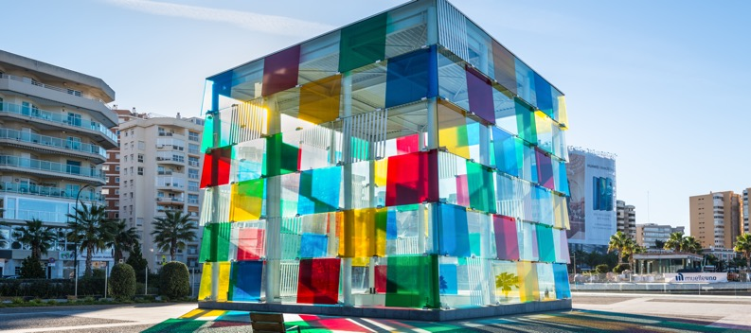
In addition, another significant public body in the field of social entrepreneurship is the Center for Social Entrepreneurship which was founded in 2006 at Roskilde University with a Government grant worth almost €1.5 million. The purpose of the Center is to become a “greenhouse” for learning and building competences in social entrepreneurship, with a view to improving the living conditions of socially marginalized people. The center offers different kinds of education in relation to social entrepreneurship.²⁹
Greece is more focused on providing supporting policies related to the digital transformation of cultural heritage. Despite the fact that cultural innovation does not exist as an official definition in Greece, however there are various acts at a policy level that imply how cultural innovation is tightly linked with cultural heritage, digital transformation, science and technology.
In specific, during 2007-2013, there have been developments driven by programmes in the context of the "Digital Convergence" Operational Programme of the Ministry of Economy, part of the 4th Community Support Framework programme in the area of Information Society Technologies (2007-2013). Call 31 of the programme, launched in late 2011, amounted to ca. 60 million EUR and supported projects related to the digitisation of cultural heritage, popular and contemporary culture assets, their enrichment, access through web services and mobile devices apps, and integration within a unified metadata repository. The emphasis was on final delivery of cultural content to audiences and markets, both national and international, among other channels through exposure to the European platform.³⁰
²⁹ http://www.ruc.dk/forskning/forskningscentre/cse/
³⁰ https://www.culturalpolicies.net/database/search-by-country/country-profile/category/?id=16&g1=2

Slide 33
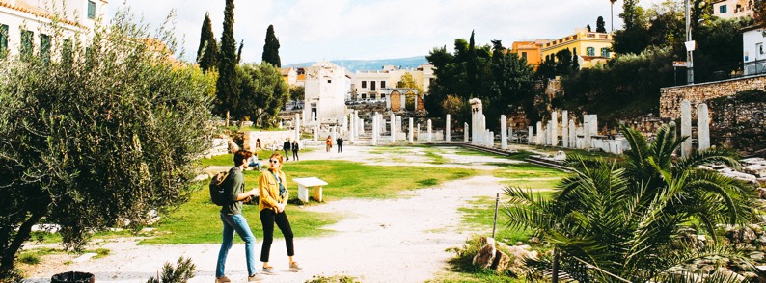
In continuation, in the context of the implementation of the European Structural and Investment Funds 2014-2020 in the field of Research, Technology and Innovation, the General Secretariat for Research & Technology of the Ministry of Education, Research & Religions in collaboration with the Ministry of Culture and Sports announced the special action of Open Innovation in Culture focusing on "Culture, Cultural Heritage, Science and Technology”. ³¹
In addition, according to the National Documentation Center, whose institutional role (as a digital and physical infrastructure of national scope) is to collect, organize and preserve the entire Greek scientific, research and cultural output (content and data) disseminating it at both national and global level, it is important to take into consideration that Europeana Innovation Agenda highlights research and innovation priorities for the cultural heritage sector.³² Here it is interesting to mention the fact that, in 2019, the National Documentation Center was moved from the Ministry of Education to the Ministry of Digital Governance. To our understanding, this implies that cultural innovation is highly linked with digital transformation. In fact, a Bible of Digital Transformation 2020-2025 has been published by the Ministry of Digital Governance, highlighting the need for digital innovation. In particular, it is pinpointed that one of the most critical pillars for the digital economy is the creation of Digital Innovation Hubs (DIHs), which are "one-stop services" to support businesses in the digital transformation of their production processes and promote their innovation using digital technologies.³³
Last but not least, focusing only on the importance of social enterprises within the Greek context, it is worth mentioning the initiative of one of the Municipalities in the periphery of Attica (Athens), the Municipality of Kallithea, that has created a network of social innovation whose main focus was on supporting unemployed people in founding social enterprises. To our understanding, this could be considered as an implication that from a top down approach social innovation is linked with social enterprises and policies at a state level should support such initiatives and contribute to the amelioration of the living conditions of more vulnerable groups of people.
³¹http://www.gsrt.gr/central.aspx?sId=124I458I1163I646I509701&olID=777&neID=589&neTa=1_21286&ncID=0&neHC=0&tbid=0&lrID=2&oldUIID=aI777I0I119I428I1089I0I3&actionID=load&JScript=1
³² https://pro.europeana.eu/page/europeana-innovation-agenda; http://blog.openaccess.gr/?p=4431
³³ https://digitalstrategy.gov.gr/sectors/digital_innovation; https://digitalstrategy.gov.gr/; file:///C:/Users/Vera/Downloads/digital_strategy.pdf

Slide 34


Going further and exploring the case of Ireland, there are 4 supporting policies:
Creative Ireland 2017-2022
Creative Ireland is a five-year all-of-government initiative, from 2017 to 2022, which at its core is a wellbeing strategy which aims to improve access to cultural and creative activity in all 32 counties in Ireland. Creative Ireland will prioritize children's access to art, music, drama and coding; enhance the provision of culture and creativity in every community; further develop Ireland as a global hub for film and TV production; empower and support our artists; drive investment in our cultural institutions; and further enhance Ireland's global reputation abroad. From 2018, an annual County of Culture has also been held each year. Enabling the Creative Potential of Every Child, Enabling Creativity in Every Community, Investing in our Creative and Cultural Infrastructure, positioning Ireland as a Center of Excellence in Media Production and Unifying Ireland's Global Reputation are the five key pillars of the programme.
Ireland 2040
Project Ireland 2040 is the Irish government’s long-term strategy to make Ireland a better country for all and to build a more resilient and sustainable future. The strategy ensures the alignment of investment plans with the stated National Strategic Objectives for 2040 in a considered, cohesive and defined manner. Alongside the development of physical infrastructure, Project Ireland 2040 supports business and communities across all of Ireland in realizing their potential. The aim of Project Ireland 2040 is to construct an improved Ireland for all who live there. By 2040, there will be approximately one million additional people living in Ireland. This population growth will require hundreds of thousands of new jobs, new homes, heightened cultural, and social amenities, enhanced regional connectivity and improved environmental sustainability. Project Ireland 2040 sets out to deliver these.

Slide 35

Investing in our Culture, Language and Heritage 2018-2027
Investing in Our Culture, Language and Heritage 2018-2027 is a ten year plan setting out the Government's commitment for capital investment of almost €1.2 billion in Ireland’s culture, language and heritage. This strategy outlines how the €1.2 billion will be invested in Irish culture, heritage and language infrastructure as part of Project Ireland 2040.
€460 million for National Cultural Institutions.
€265 million for cultural and creativity investment programme.
€285 million for natural and built heritage.
€178 million for the Gaeltacht, the Irish language and the Islands.
PRIORITY PROJECTS UNDER THE NATIONAL CULTURAL INSTITUTIONS INVESTMENT PROGRAMME OF €460 MILLION ARE:
01
National Library of Ireland renovation;
02
National Archives of Ireland renovation;
03
National Museum of Ireland master plan redevelopment;
04
National Concert Hall renovation;
05
Crawford Art Gallery redevelopment;
06
National Theatre redevelopment;
07
Irish Museum of Modern Art renovation;
08
National Gallery of Ireland – further phases of the master plan redevelopment;
09
Chester Beatty Library improvements.

Slide 36


National Social Enterprise Policy 2019-2022
Social Enterprises are businesses whose core objective is to achieve a social, societal or environmental impact. Like other businesses, social enterprises trade in goods or services on an ongoing basis. However, any surpluses they generate are re-invested into achieving a social impact. The first National Social Enterprise Policy for Ireland 2019-2022 is focused on three key objectives:
01
building awareness of social enterprise,
growing and strengthening social enterprise,
and achieving better policy alignment.
02
03

Slide 37
The Policy sets out a series of 26 commitments on the part of Government across these three objectives for the development of social enterprise over the period 2019-2022. These commitments will be delivered in partnership with social enterprise stakeholders. The objective of the Policy is to support social enterprise to grow in scale and impact.
The current policy in Ireland directly overseeing Social Innovation is the above mentioned National Social Enterprise Policy for Ireland.³⁴ The policy acknowledges Social Entrepreneurship and Innovation as small but important parts of the Irish enterprise ecosystem, and that it is highly reliant on private donation, voluntary assistance and the aid of organisations such as Social Innovation Fund Ireland. This policy highlights the different interpretations of social innovation between countries and cultures, however it does not attempt to combine or mention the link between social innovation and culture.
On the cultural aspect, Ireland has a policy known as Culture 2025 that defines the scope and sets the policy in the whole cultural field. This policy links in with other existing Irish policies such as the Creative Ireland Programme 2017-2022, Investing in our Culture, Language and Heritage 2018-2027 and Heritage Ireland. The Culture 2025 policy focuses on the link between culture and creativity, supporting the link between creative practice and cultural participation. However, the term 'social innovation' is not mentioned once in the policy, indicating that Culture and Social innovation aren't seen in the same context.
Besides, currently there is a new 3-4 year undergraduate Bachelor of Arts Degree available in Social Sciences and Cultural Innovation at Dublin City University. This is a full time level 8 course providing students with a unique suite of modules from the fields of Sociology, Media, Politics and Innovation. This future-focused programme is designed to equip students for the 21st century workplace and a world defined by increased connectivity and rapid technological change. It aims to bring an applied focus to the Social Sciences, providing students with the opportunity to actively engage with areas such as social entrepreneurship and cultural innovation, as well as the chance to gain valuable work experience. The BA in Social Sciences and Cultural Innovation also places a strong emphasis on the development of transferable skills, such as creativity, leadership, ethical and critical thinking, digital literacy, intercultural competence, and future thinking, all which have been identified as important for 21st century living and working. ³⁵
In 2019, in order to jointly develop concrete solutions, the European Commission launched a series of conferences over a two-yearly period on the future of heritage, meant as global problem solving platforms. The first conference was held on the 1st of April at the National Concert Hall, Dublin, Ireland – “Cultural Heritage and Social Innovation”.
Dublin was selected as the city for the first Platform on the Future of Cultural Heritage as it has been particularly active in the field of cultural heritage and social innovation. The city is at the forefront in this area, offering a rich programme of experimentation in this regard.
³⁴ 2fae274a44904593abba864427718a46.pdf (assets.gov.ie)
³⁵ https://www.dcu.ie/courses/undergraduate/salis/social-sciences-and-cultural-innovation

Slide 38

According to statistics and sources from the British Council,³⁶ in 2016, the UK government released a strategy Social investment: The UK as a Global Hub. This international strategy aims to attract social investment to the UK and encourage foreign social enterprises to be set up in the country. In addition, it seeks to support increased exports and franchising by the UK social enterprises and intermediaries in foreign markets, and to bring back learning from successful social sector innovations and practices overseas.
According to Social Enterprise UK’s State of Social Enterprise Survey 2015, social enterprises are outperforming small-medium enterprises in turnover growth, workforce growth, job creation, innovation, business optimism, start-up rates and diversity in leadership. Their growth is supported by a vibrant intermediary sector that includes Social Enterprise UK, the national body, and a host of organisations providing specialist support such as incubators, impact measurement bodies and investors as well as universities.
The UK governments have worked to support the growth of the social economy. This has resulted in innovative legislation such as the creation of the Community Interest Company -a company form for social enterprises- and the launch of the Social Value Act, which requires officials to consider social and environmental impact when contracting for public services (effectively encouraging government procurement from social enterprises).
The State of Social Enterprise Survey found that 14% of UK social enterprises exported or licensed overseas in 2015 and this proportion is expected to increase rapidly in coming years. 30% of entrepreneurs going through the UK’s leading social technology incubators come from outside the UK, thus provoking the cultural aspect even though they have not made clear the connection of cultural and social innovation as it is outside cultures that are showing successes.
³⁶ https://www.britishcouncil.org/society/social-enterprise/news-events/news-uk-international-social-investment-strategy

Slide 39
In July 2021, however, the UK government did release a Cultural Strategy, which involves creating a Good Practice Exchange to develop, test, evaluate and identify any areas for improving culture sourced from the community, bringing together people from across the sector to work creatively. This will look at interventions across talent, bullying and harassment, diversity and inclusion, recruitment, leadership and beyond to shift the social society to a more diverse and sustainable future. Investing back in the community and helping people to develop and grow their skills sets can impact the social well being of all involved, and helping to create the spaces needed for these individuals to grow can advocate for cultural, social innovation.
A positive, inclusive and respectful culture that attracts a diversity of people From (status quo) To (outcomes they want to achieve) A research culture which is not seen as open and inclusive puts off and drives out talent, preventing individuals from producing their very best work. There is a positive, inclusive and respectful culture that attracts a diversity of people to work and thrive in research-and-development in the UK and encourages them to stay.
In addition, the organisation UK Research and Innovation (UKRI) states that
“
“people and culture are fundamental to research and innovation because they drive the creative and dynamic system that we need to support the community to thrive. A positive research culture supports not just researchers and innovators but also the entire ecosystem which supports the research and innovation endeavor. We strive to foster a system where everyone is appreciated and valued, that works for everyone, by everyone”.

Slide 40
This UK based organisation offers the support for researchers and innovators around the ideal of cultural social innovation. They recognize the need for the development within communities and how culture can advocate for social change. They have created an online hub that will help to foster a research and innovation system where diverse and dynamic people and ideas can thrive. This research resource hub is an excellent tool to bring together policies, standards and guidance to support researchers, innovators and organisations. They have a number of guidance sections regarding the below topics:
Guidance to support people in research and innovation.
Discover ways to support diverse and inclusive research and innovation.
Inspire, support and develop the diversity of people in research and innovation.
Find guidance on safeguarding and preventing bullying and harassment.
Guidance , policies and standards on research ethics and integrity, open research and responsible innovation.
Learn about co-production, collaboration and public involvement in research.
Get guidance on responsible research and innovation during the pandemic.
Get guidance on research with children and young people.

Slide 41

By providing these policies and guidance any organisation/community group is able to develop more knowledge on how to collect the research they need to ensure the fulfilment of a certain project, or if there is a need for resources to be placed within a different element of the group. This can help advocate for social changes within communities, especially remote areas where research can be done to find the desires of the community.
Lastly, in the Italian context, the most recent policy established by the Department of Public Administration of the Presidency of the Council of Ministers³⁷ (Budget Law of 2018) is the Social Innovation Fund. The Fund was established with the aim of selecting and financing experimental social innovation projects, in the three-year period 2018-2020, as part of the "three-year program for social innovation". The main purpose of the Social Innovation Fund is "to enhance social innovation according to European standards through the realization of feasibility studies and the development of the capacity of public administrations on the basis of achievable results".³⁸ The public administration is of particular importance as the main interlocutor of the initiative. The reference macro-areas of intervention are social inclusion, cultural animation, and fighting against early school leaving.
³⁷ http://www.funzionepubblica.gov.it/innovazione-sociale
³⁸ http://www.funzionepubblica.gov.it/innovazione-sociale

Slide 42
4.1.3. Legislation and taxation
In Hungary, there is no legal definition of social enterprises and of social economy. The institutional form of social enterprise in Hungary exists under the label of social cooperative defined by the 141/2006. (VI. 29.) governmental decree on social cooperatives.³⁹ Social cooperatives often provide employment opportunities for the long-term unemployed or groups who are disadvantaged on socio-economic grounds.
Social cooperatives appeared after 2006, introduced by new legislation establishing this new organisational form,⁴⁰ and offering them certain tax advantages (as compared to normal employment contracts). From 2006 to 2020, social cooperatives were the most visible form of social enterprise in Hungary and relatively widespread, boosted by public and European funds made available for establishing and operating them. Statistics show that after 2019, due to decreasing funds and subsidies, the number of social cooperatives has fallen dramatically.
Besides, there are also some entities operating as non-governmental organisations which fulfill the EU operational criteria, and, hence, can be seen as social enterprises – with different legal forms, such as association, foundation, non-profit Ltd. Associations and foundations (CSOs) have certain tax and duties benefits and exemptions available – for e.g. receiving exemption from paying value added tax (VAT) for some activities or advantages regarding labor costs. organisations with public benefit status can have even more advantages than non-governmental ones.
In recent years, we can also find many social start-ups that combine the business logic with social needs, meaning that they are for-profit organisations which from the beginning aim to help society. Despite this potential social feature, generally start-ups are established as for-profit entities (e.g. LP, Ltd.), and as such they are not eligible to receive tax and duties benefits like CSOs. Due to their legal form they are subject to different legal and tax regulations.
In the Danish context, although there is a law referring to social enterprises,⁴¹ this was adopted only from 2015 onwards. According to this law adopted by the Danish Government, social enterprises have been able to register if they meet the 5 criterias for being a social enterprise as set in the law.⁴²
³⁹ http://www.jogiportal.hu/index.php?id=sj6hle501xvc9o8c2&state=20110901&menu=view
⁴⁰ Legal basis of social cooperatives was defined by the 141/2006. (VI. 29.) governmental decree on social cooperatives. Social cooperative was introduced as a new organisational form, developed concept of Traditional cooperatives - a legal statute known in Hungary since the 19th century, which meant cooperatives more like the special ownership structure of the company, with less explicit social aims.
⁴¹ http://www.folketingstidende.dk/RIpdf/samling/20131/lovforslag/L148/20131_L148_som_vedtaget.pdf
⁴² http://socialvirksomhed.dk/en/about-social-economy-idenmark/the-criteria-to-be-labelled-a-social-enterprise

Slide 43
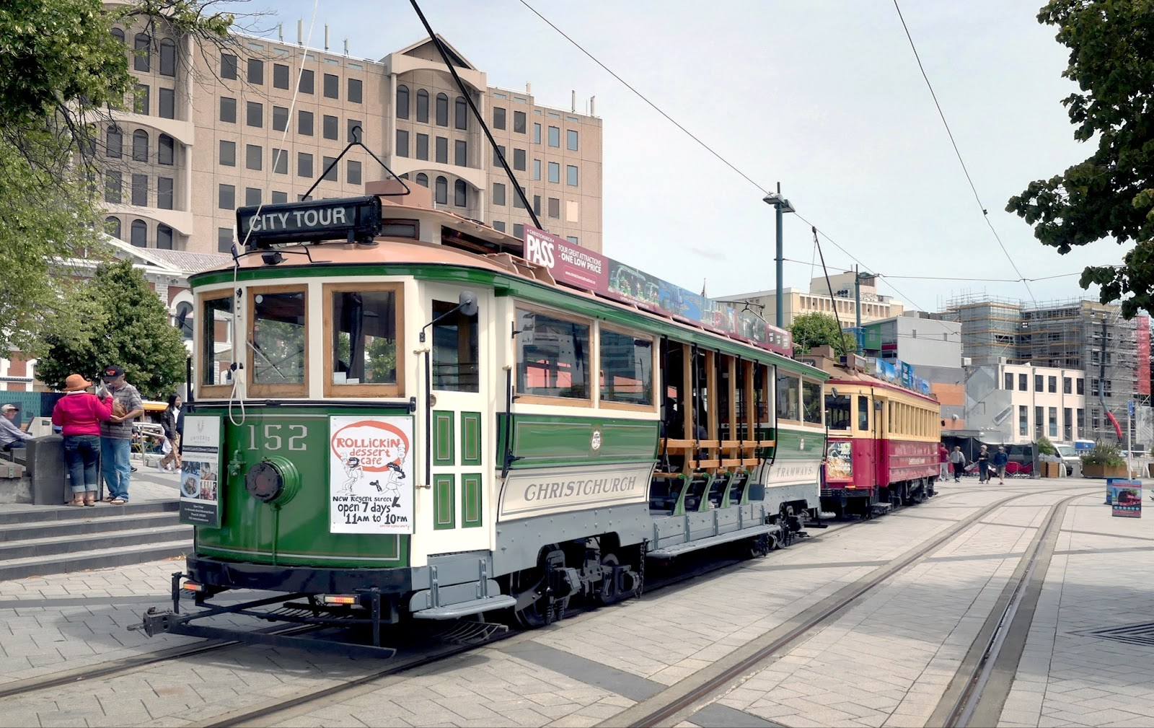
THESE CRITERIA ARE THE FOLLOWING:
01
Social purpose - the enterprise must have a primary purpose that is beneficial to society with a social, cultural, employment-related, health-related or environmental aim.
Significant commercial activity - The enterprise must sell either goods or services. This activity must constitute a significant element of the revenue generated by the enterprise.
Independence of public authorities - The public authorities must not have any significant influence on the management or operation of the enterprise.
Inclusive and responsible governance – The enterprise must involve employees, customers, partners and stakeholders. In addition, the company must be managed responsibly in accordance with the social objectives.
Social management of profits - The enterprise must spend its profits on social objectives or reinvest the funds. However, a limited share of profits may be distributed as dividends to investors or owners. Profits should be reinvested in the enterprise, invested in other registered social enterprises, donated to charitable organisations or distributed as dividends to owners and investors to a limited extent.
02
03
04
05
Boon class tram No 152." by Bernard Spragg is marked with CC0 1.0.

Slide 44


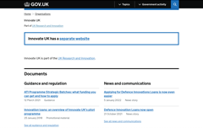
As for the tax incentives, it is worthwhile to mention that the Danish Government set aside 42.6 million DKK for social enterprises in the years 2012-2015.
Moving onwards in the Greek context, there have been developments during 2007-2013 driven by programmes in the context of the "Digital Convergence" Operational Programme of the Ministry of Economy, part of the 4th Community Support Framework programme in the area of Information Society Technologies (2007-2013). Call 31 of the programme, launched in late 2011, amounted to ca. 60 million EUR and supported projects related to the digitisation of cultural heritage, popular and contemporary culture assets, their enrichment, access through web services and mobile devices apps, and integration within a unified metadata repository. The emphasis was on final delivery of cultural content to audiences and markets, both national and international, among other channels through exposure to the Europeana digital library.⁴³
In continuation, in the context of the implementation of the European Structural and Investment Funds 2014-2020 in the field of Research, Technology and Innovation, the General Secretariat for Research and Technology of the Ministry of Education, Research and Religions in collaboration with the Ministry of Culture and Sports announced the special action of Open Innovation in Culture focusing on "Culture, Cultural Heritage, Science and Technology”.⁴⁴
Meanwhile in Ireland, and in recognition of the valuable contribution social enterprises make to society and the economy, the Social Enterprise Development Fund was set up to encourage social entrepreneurship. The Social Enterprise Development Fund is a €3.2 million pot of money which is being delivered over four years from 2018 to 2022, by offering a cash grant to social enterprises that meet the criteria.
Info on how the UK governments can support CSI:
CLICK TO VIEW
UK Innovation Strategy:
CLICK TO VIEW
CLICK TO VIEW
⁴³ https://www.culturalpolicies.net/database/search-by-country/country-profile/category/?id=16&g1=2
⁴⁴http://www.gsrt.gr/central.aspx?sId=124I458I1163I646I509701&olID=777&neID=589&neTa=1_21286&ncID=0&neHC=0&tbid=0&lrID=2&oldUIID=aI777I0I119I428I1089I0I3&actionID=load&JScript=1

Slide 45

Lastly, in Italy the history of social enterprises spans nearly 40 years, encompassing diverse development trends across the various legal forms that make up the social enterprise spectrum:
social cooperatives;
associations and foundations;
mutual aid societies;
limited liability companies; and
traditional cooperatives
(e.g., community cooperatives).
The development of social enterprises is closely linked to the history of Italy and particularly to its civil society and welfare system. The main innovation of the new legal framework on "social enterprise" (Law 118/2005 and Legislative Decree 155/2006) consists in the enlargement of the legal forms that can be used to set up a social enterprise. The new legal framework does not consider the legal form a condition for eligibility as a social enterprise. The law introduces the legal category of "social enterprise", which takes the form of a voluntary "qualification". It allows any organisation to qualify and be legally recognised as a social enterprise regardless of its legal form, provided that it complies with the following criteria:

Slide 46

The development of social enterprises is closely linked to the history of Italy and particularly to its civil society and welfare system. The main innovation of the new legal framework on "social enterprise" (Law 118/2005 and Legislative Decree 155/2006) consists in the enlargement of the legal forms that can be used to set up a social enterprise. The new legal framework does not consider the legal form a condition for eligibility as a social enterprise. The law introduces the legal category of "social enterprise", which takes the form of a voluntary "qualification". It allows any organisation to qualify and be legally recognised as a social enterprise regardless of its legal form, provided that it complies with the following criteria:
It is a private legal entity;
It engages in the regular production and exchange of goods and services having "social utility" (i.e., it engages in one or more of the entitled sectors specified by the same law) and seeking to achieve a public benefit purpose rather than to generate a profit. An organisation is considered a social enterprise if it generates at least 70% of its income from entrepreneurial activities (i.e., production and exchange of goods and services having social utility);
It is allowed to make a profit, but it cannot distribute it to its members or owners (non-distribution constraint). All profits have to be reinvested to further its main statutory (public benefit) goal or to increase its assets, which are fully locked;
It is registered in the Social Enterprise Section of the Register of Enterprises managed by the Chamber of Commerce; and
It publishes both its financial and social balance sheets.

Slide 47
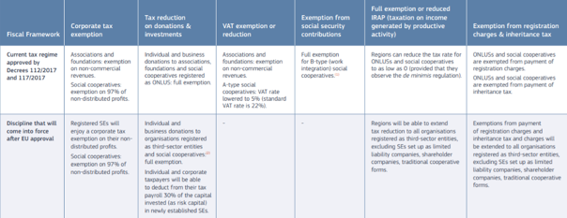
⁴⁵
Table 3. Fiscal framework for social enterprises in Italy (current and after approval of third sector and social enterprise reform)
4.1.4. Ongoing movements
Discussing the existence of ongoing movements that could allow us to understand Innovation as the expression of movements that create a more open and socially acceptable society and culture, it is interesting to mention that only some of the under investigation countries have some input to share; and also these movements are very different in terms of content and context to each national setting.
More specifically, only Denmark, Hungary and Ireland have something to offer in this discussion at a national level. In particular, Hungary has to promote the SozialMarie prize,⁴⁶ a prize for social innovation awarded to 15 outstanding projects every year since 2005. It has been the first prize for social innovation in Europe. Beyond financial recognition, it primarily offers a public platform for social innovation projects in Central Eastern Europe. SozialMarie is a prize for successfully implementing socially innovative projects in Austria, Hungary, the Czech Republic, Slovakia, Croatia and Slovenia. Lastly, for Ireland, it is interesting that the Irish partner of this project highlighted two recent movements which brought about innovation in Irish culture and society; the 2015 Marriage Equality Referendum and the 2018 Abortion referendum. Both were national movements that brought about constitutional change by legalising marriage between members of the LGBT+ community and legalising access to abortion for women in Ireland. Irish people believe these changes have brought about a more open and socially acceptable society and culture.
⁴⁵ file:///C:/Users/39338/Downloads/Social%20 enterprises%20and%20their%20ecosystems%20in%20Europe.%20Updated%20country%20report%20Italy.pdf
⁴⁶ https://www.sozialmarie.org

Slide 48

4.2. Presentation and analysis of the outcomes of the field research
In this chapter, we are going to present the best practices per country, highlighting their field of work as well as the innovative aspects of these initiatives as described by their representatives. At the end of each case study, we will attempt to make a summary and connect the presented information with the under investigation topic of cultural social innovation.
4.2.1. Hungary
Three case studies were selected to be presented ; one is a specific initiative from a Roma informal educational foundation and the other two are social enterprises.
The Uccu Roma Informal Educational Foundation⁴⁷ has developed an initiative called Uccu Roma City Walks. The Uccu Roma Informal Educational Foundation (Uccu) was established in 2010 with the aim of creating a platform for meeting and dialogue between Roma and non-Roma youngsters, and reducing the stereotypes and prejudices against Roma. The main mission of Uccu is to combat prejudices and negative stereotypes related to Roma, to contribute to a more tolerant and open society. The Foundation offers eight different educational modules related to cross-cultural sensitivity and the intangible cultural heritage and history of Roma.
01
⁴⁷ https://www.uccusetak.hu/en/; https://www.uccualapitvany.hu/en/

Slide 49
The most popular of these activities is the walking tour which takes place in the 8th District of Budapest and in the city of Pécs. The 8th District in Budapest has historically been populated by Roma people and was often considered unsafe by non-Roma people. These interactive tours invite the participants to discover the district and their link to the cultural heritage of Roma. The success of the tours has led to this becoming the Uccu Foundation’s first social innovation. Uccu Roma Walking Tours offer interactive, innovative Roma-led walks in Budapest and Pécs in Hungarian and English. Participants acquire a cultural experience, get a more authentic picture of the Roma by obtaining general knowledge about them. Also, they are enriched by the personal stories of the Roma guides and can address their questions. The walks are led by the foundation’s volunteers, young Roma aged 18-35. With this volunteering they not only gain moderating and work experience, but it encourages them to be proud of their rich heritage, which strengthens their identity. They offer tours for companies (as team building activity) to generate revenue and thus finance the social involvement.
The walk is unique in that it is led by the foundation’s Roma volunteer youth. They share personal experiences of the area and talk about a neighbourhood that is mostly inhabited by Roma. During the walk, participants can ask any questions. The Roma origin of the respondents and their personal experiences related to the district make the common experience authentic. In this way, they can contribute to the discovery of the values of the area and the reduction of fears and prejudices.
In Budapest, there are many initiatives that offer thematic urban walks with interesting, unknown stories from the history of Budapest, provide socio-cultural experiences, and help the participants to see the city from a different, special angle. These urban walks are targeting mainly locals and provide alternative sightseeing to ordinary city neighbourhoods and introduce them with social historical curiosities. However, compared with them, Uccu Roma Walks has an extended mission. It is a great example of cultural social innovation which provides a platform for building a more cohesive society, exchanging experiences and dialogue in everyday life, using cultural heritage. Furthermore, it contributes to the young volunteers' skills and competence development, and encourages them to be proud of their cultural heritage, which strengthens their identity. For the young Roma, these public tours are certainly good for their self-esteem, in both individual and social contexts.
In 2020, the Foundation was awarded with the Europa Nostra Award. The European Heritage Awards / Europa Nostra Awards were launched by the European Commission in 2002 and have been run by Europa Nostra – the European Voice of Civil Society Committed to Cultural Heritage – ever since. The Awards have the support of the Creative Europe programme of the European Union.⁴⁸
⁴⁸ https://www.europanostra.org/europes-top-heritage-awards-honour-21-exemplary-achievements-from-15-countries/;
https://www.europeanheritageawards.eu/winners/uccu-roma-informal-educational-foundation/

Slide 50
Matyodesign⁴⁹ is a social enterprise from Tard, a little village in Borsod County in Hungary, established in 2010 by a young woman entrepreneur. The traditional folk art of the Matyó community in and around the town of Mezőkövesd in north-eastern Hungary is characterized by floral motifs that are found in flat-stitch embroidery and ornamented objects. Matyó embroidery decorates the traditional dress of the region. The floral motifs have played a crucial part in strengthening the self-image and identity of the Matyó community and are employed in interior decoration, contemporary fashion and architecture, in addition to embroidery. Most often practiced as a communal activity, embroidery strengthens interpersonal relationships and community cohesion, while allowing for individual artistic expression.
It is on the list of UNESCO’s intellectual heritage. The aim of the Matyodesign social enterprise is to keep the motifs and tradition alive, to connect the traditions and the young metropolitan culture, the current fashion. Matyodesign gives employment to 27 women from Tard in a county with a high unemployment rate. The mission of Matyodesign is not only to keep the tradition alive, but also to recreate it on a high-quality level, to keep its uniqueness, while making it resilient to the challenges of the current trends. Matyodesign also puts emphasis on principles, such as ethical corporate model, creating timeless values instead of disposable products, responsible shopping and sustainability.
More specifically, Matyodesign is a social enterprise and fashion brand, established in 2010. Their products are handmade, created by women of Tard village who are the traditional knowledge preservers. Matyo embroidered clothes and textiles are available in the webshop, which has more than 30 resellers by now. The main target group of the brand are young and middle aged city women. They would like to connect tradition and modernity. Nowadays, ethno fashion is quite popular worldwide, many traditional patterns and pieces of clothing became commercial, copied. As a side activity they also organize tours to the village mainly for companies as team building activity to introduce the visitors the local culture, and provide them unique experience and program (competition, cooking, baking, trying embroidering and local physical activities). It gives a nice combination of rural and cultural tourism, as well as experiential tourism.
To understand the importance of the presented case study we should be aware of the fact that one-third of the population of Hungary lives in small, isolated villages where there is little opportunity for dignified jobs and livelihoods. Tard is one such village located in the Matyó region of Hungary. Approximately 80% of the people in the village do not have jobs. The Matyó culture is renowned for the beauty of its traditional embroidery and craftsmanship, but it is endangered as the number of people skilled in these techniques dwindles. Matyodesign creates clothing embellished with traditional motifs from the region. The clothing is embroidered by older local women who are experts in this traditional art form, and who have difficulties finding employment elsewhere in the region. It is worthwhile to mention that Matyo, as it is a social enterprise, has a profit-oriented feature, but it also presents a successful way of revitalization of intangible cultural heritage, the local economy development in a deprived area, as well as intergenerational cooperation and women empowerment. They are all key elements of cultural social innovation.
02
⁴⁹ https://matyodesign.hu/; https://www.facebook.com/matyodesign/

Slide 51
The Auróra Civil and Community House⁵⁰ is a social enterprise and community place which was created to connect cultural programs, civil and activist organisations work, and community building in an open community. They are committed to form a stable base, where individuals, groups, non-profit organisations could meet, share their ideas and collaborate with each other on new initiatives. One of the most important goals of the Auróra project is the strengthening of the civil sector, inspire cooperation among the organisations and to provide them publicity. At the moment, they host eight NGOs who focus on marginalized and stigmatized groups. Auróra’s long-term goal is to create an innovative and self-sustaining practice which increases the number of socially active citizens to advance the broadening of democratic practices in Hungary. The three storey building’s refurbishment was started by about fifty volunteers parallel with the community-based planning of the building’s organisational structure. Democratic and participatory working groups were created around the different aspects of operating such a house. Major decisions in Auróra are made by the “plenary” -a democratic, participation based decision making body- the members of which are the working-group members and the representatives of the NGOs who rent offices in the house. Event organizing, communication, design and community organizing works are still voluntary based.
The AURÓRA Civil and Community House started in the fall of 2014 as a self-sustaining social enterprise that provides space for individuals, groups and non-profit organisations working in different social, political and cultural fields to share their ideas, build new relationships and create new cooperative projects. Working together with hundreds of volunteers, they mobilized thousands of people, engaged more than 70 civil organisations, and hosted hundreds of programs. There is a need for it, and there is a critical mass of well-skilled and committed people who are willing to make it happen. Their model works through the utilization of revenue generating resources such as café, catering service, the lease of office space and other spaces, by operating and leasing parking spaces and ticket sales. A second level of sustainability is the aspect of human resources. A model for organizing volunteers and gaining expertise, which enables the place to work on a daily basis. organisational sustainability is crucial, it is needed to collect and process the organisational experiences, and pass down the lessons and knowledge to new members. Furthermore, community organizing is part of environmental sustainability. By fitting in to the neighbourhood and doing a positive impact, the work can be efficient not just locally but beyond. Auróra is a community place, bar, they rent out space for other social initiatives, groups and NGOs, running a community garden and community compost, organizing and hosting different kinds of events (workshops, debates, trainings), social campaigns, concerts.
The existence of a socially responsible, democratic, self sustaining social enterprise is strategically important in Hungary. By using the tools of community decision making and focusing on social justice, Auróra’s aim is to strengthen the civil sector’s skills and knowledge, and by providing space to enhance their networking opportunities, as well.
This enterprise model is easily transferable into other European contexts without any difficulties. The necessary resources are: volunteers in the society, committed management team with entrepreneurial skills, fundraising motivations and co-operations with other NGOs, openness towards atypical financial resources (e.g. linked services, supplementary activities). The Auróra Civil and Community House can be a model for a social enterprise, which helps the cooperation between the actors of the civil sector and provides opportunity to learn the democratic process through participation.
03
⁵⁰ https://auroraonline.hu/; https://www.facebook.com/auroraunofficial

Slide 52

To sum up, the first case study relates the power of cultural heritage with the aspect of social innovation, even though this is not foreseen or discussed at an institutional or systemic level. It also highlights the importance (for social innovators) to empower disadvantaged groups. The second case study shows how social innovation in Hungary is intertwined with social enterprise. Yet, its impact is multidimensional, as it combines the revitalisation of intangible cultural heritage, the empowerment of women, the local economy development, and the fight of unemployment. Thus, it proves the point that, in Hungary, social innovation provides new or novel answers to a community’s problems with the goal of increasing the well-being of the community (in this case, the Matyo community). It also proves that cultural social innovation applies foremost in tourism and involves local communities, disadvantaged groups, supports fair trade and sustainability, and puts emphasis on the protection of common cultural heritages, as well as on preservation of local values. The last case study is important as it presents an enterprise model easily transferable into other European contexts without any difficulties. The necessary resources are: volunteers in the society, committed management team with entrepreneurial skills, fundraising motivations and co-operations with other NGOs, openness towards atypical financial resources (e.g. linked services, supplementary activities). The existence of a socially responsible, democratic, self sustaining social enterprise is strategically important in Hungary. By using the tools of community decision making and focusing on social justice, Auróra’s aim is to strengthen the civil sector’s skills and knowledge, and by providing space to enhance their networking opportunities, as well.

Slide 53

4.2.2. Greece
In the case of Greece, we have selected two non-profit organisations and one social enterprise. Each of them focuses on a different social and/or cultural innovative element, but the two key characteristics to be highlighted are the aspect of digital transformation and the model of sustainability they follow.
01
Victoria Square Project (VSP)⁵¹ is a contemporary artwork and -at the same time- a physical space of reference for the neighbourhood, acquiring its meaning and value in the context of urban development and neighbourhood planning around its particular urban area. Currently it operates as a contemporary art space focused on the empowerment and inspiration of the residents of Victoria (Athens, Greece).
VSP aims to be a catalyst for highlighting the importance of culture, art and creativity to build a more humane society. In this way, it offers an alternative to that sovereignty model of devaluation and/or ignorance for the value of existing populations and diversity VSP also seeks to be a social meeting point in which intercultural relations are developed, a creative platform that will enhance cultural exchanges and strengthen the region's community. Its target groups are artists, architects, researchers, local entrepreneurs, educators, academic institutions, neighbours and various other organisations.
⁵¹ https://www.victoriasquareproject.gr/

Slide 54
It has its own unique identity as it is a space of contemporary art that is strongly connected with the community and aims at its strengthening. VSP is a social sculpture! And what does this mean? That it is what people make of it and it implies caring for society as if it were a collective work of art. How can art bring social changes? In this question, the answer is through the existence of a “living room” for the whole neighbourhood. And this is exactly what VSP is. Working with various community initiatives, local businesses, institutions, the municipality, artists, and other individuals and groups, Victoria Square Project seeks to elevate the cultural and historical assets of this vital crossroads in Athens.
The initial planning expanded beyond the time frame of documenta 14 with the aim to become a long term commitment towards the community. Although it was initially thought that the space would last for only a year, VSP has become a part of the everyday life of the Victoria neighbourhood. It is the result of the large engagement of the neighbourhood as well as the large participation of artistic groups and initiatives who have been present and active at VSP, urging its continuation. And its continuation was succeeded thanks to European funding programmes, cultural centres grants and state funds. Currently they are working on a private plan of securing funds, such as fees, memberships and crowdfunding policies.
From 2019 onwards the main activities of the initiative focus around the question “who is the contemporary Athenian?” This is a research question that is being developed with the aim to have a concrete contribution in identifying this collective identity and putting in the public sphere more actively the questions of belonging, democracy, the crisis, fascism, while empowering the local community with a special focus on the youth, and become a reference for community engaged art projects in Greece.
Under this theme, the specific developed and developing activities are:
the creation of the Living Room, an organic meeting point for the neighbourhood;
the programs for artistic inspiration and empowerment (Victoria NOW): Young people, children, neighbours of all ages and with different cultural and social backgrounds come together and discuss burning issues such as immigration, identity, gender, the economy through art workshops and through co-creating collective works that reflect the contemporary identity of this multicultural neighbourhood;
the AIR, an artists’ residency; and
the Hood activities that deal with interventions in the public space, mapping games, live archive of playful responses and interactions.
What is outstanding in this initiative is its sustainable existence. It is impressive how VSP started as an artwork of a German artist, Rick Lowe, within the framework of Documenta 14, titled “Social Sculpture”. It took place in an Athenian zone that, in 2016, was transformed into an improvised refugee camp. Rick Lowe, along with local actors, found ways to build bonds and start dialogues linking art and culture with small businesses as well as with immigrant and refugee support networks. Right now, 4 years later, this social sculpture is dynamically being evolved to a contemporary art space with strong linkages to the society and the community. Innovation is nurtured through society and arts that go along together and create space for discussion, expression, creation, education and research.

Slide 55
The Shedia Home⁵² was established as a hub to discuss and provide solutions to social problems, to bring us all one step closer to a just society, to a world without poverty and social exclusion. It aims to energize, empower, train and create job opportunities for those who have experienced extreme poverty. Shedia is a means of activation and social (re)integration. It is a special opportunity for people experiencing social exclusion to ensure a decent income and rebuild their lives. The target group is homeless people and people in extreme poverty with some special focus on people over 50 years old.
The main activities of Shedia Home are:
Shedia street journal: an independent magazine, characterized by independent reporting, optimism and subversive humour. It is a general interest street journal focusing on various subjects of interest to citizens and the society, including news reports, articles, analyses and commentary on the political, social and sporting life of Greece, as well as articles on cultural topics, gastronomy and so on.
Shedia art: art products, retail stores. It is and upcycling project, where the ideals and values of love, solidarity, education, participation, social inclusion, creativity, social enterprise, innovation as well as social and environmental awareness and environmental solutions are all converging. Since March 2013, when the first issue of the Shedia journal hit the streets of Athens, the undistributed/unsold copies weren’t recycled, but, instead, they were stored to be upcycled – i.e. to be reused, redesigned and transformed into new, usable products of high quality and aesthetic value. In spring 2016, Shedia invited its vendors to participate in free upcycling workshops organized in its premises. The first group of beneficiaries were all over 50 years old. The beneficiaries were trained and are still being trained so they can create and produce on their own tens of high quality paper products, from pencils to paper bags, to earrings, ceiling lights, drink coasters etc. Their creations are available for sale through the “shediart” dedicated shop in downtown Athens (56 Kolokotroni & Nikiou Street, Athens) as well as through selected shops, museums, galleries etc. in Greece and abroad. Through the “shediart” program, people that have been harshly hit by the economic crisis, not only get access to education and employment, but are also undertaking an important social role, becoming, in effect, community leaders, as they are invited to give out seminars to schools and other fora, in order to pass on the knowledge of upcycling. They are contributing to the important cause of educating the public and building individual and collective social and environmental consciousness.
Shedia home: cafe, bar, restaurant, workshops, gift shop. In one of the most beautiful corners of Athens, a carousel of kindness and generosity has transformed a building into a unique hub of solidarity and applied social innovation. A place that has become the meeting point for all these forces that united and working together can make the world a better, fair place for all. Forces that are trying to support people, who have found themselves in a dire situation, to be able to ultimately support themselves.
02
⁵² https://shediahome.gr/?lang=en

Slide 56

This case study has a very special model of innovative elements to offer. Shedia home follows a combination of mixed practices based in their activities that enhance inclusivity, sustainability, creativity, business model existence and capacity building. Some indicative examples are:
the fact that the unsold copies of shedia press are used to create art products for sale. Shedia is the only print media outlet in the world that takes advantage of its own unsold copies in such a way. In fact, it is part of its planning to spread the word about the upcycling model.
the fact that the vendors of Shedia journal come from vulnerable population groups: homeless, long-term unemployed and other people experiencing extreme poverty and social exclusion. The cover price is € 4.00, out of which € 2.70 (out of which € 1.50 is net) goes directly to the vendor, allowing them the dignity to earn a small income to cover some of their basic needs. Shedia is not a form of begging. Readers pay € 4 to buy a notable magazine that deals with a wide range of issues, but also has a clear social orientation. The vendors of the street journal are homeless people but no one ever feels like begging, they are vendors.
the fact that as soon as you walk through the door of Shedia Home, and you lift your head up, you can see (so far) 43 hanging lampshades in the shape of little houses. These are made out of the paper of past unsold issues of “Shedia”, and each one of them represents the story of a person who, through his/her participation in “Shedia” projects, managed to move out of the state of homelessness into his/her own home.
the initiative “A coffee cup is waiting for you”, that is one can pre-pay for a cup of coffee that will be offered later to anyone who is in dire economic need and cannot afford it.
the fact that it is a social project that embodies a clear business model plan that can guarantee its economic sustainability. This business model is developed based on the power of selling (coffee, food, artistic products, etc), all the while their premises function as a wholesale and retail point of sale.
the fact that the restaurant has a braille menu as well as an acoustic description of it.
Overall, Shedia Home is a very warm and enjoyable place that embraces difference and where everyone is welcome. Also, it is an excellent example of an enterprise with a highly social orientation, yet with a sustainable development business model which combines social innovation, cultural innovation, creativity, inclusivity and income generation not only for the people running the social enterprise, but more importantly for the people that are its main target group – people that, for the majority of the society are invisible, but for Shedia, are very unique with their own stories and voices.
After the massive launch of Khom Loys, the sky is filled with the lanterns at the YeePeng Festival in Sansai Thailand 1" by John Shedrick is licensed under CC BY 2.0

Slide 57
Biennale of Western Balkans (BoWB)⁵³ is a non-profit organisation operating through a biennial festival and an annual programme in the province of north-western Greece. BoWB is active in promoting intangible cultural heritage within a contemporary context, with the vision to inspire people experiencing tradition anew, through art, technology and open knowledge.
BoWB organizes workshops that combine traditional crafts with new technologies, and works together with local communities, co-documenting cultural knowledge identified as traditional, folk, indigenous or local in open, participatory and educative ways. For instance, it is very indicative of the community art projects that it holds connecting digital art with traditional textiles and educational workshops on 3D design and traditional patterns, in connection with the Fab Lab Ioannina.
BoWB is working together with local authorities, communities of practice and other institutions and initiatives in the Balkan region, activating spaces and buildings that are connected with the local history through arts and culture. More specifically, it has collaborated with the municipal tourism office, city museums and archives, and opened up spaces to the public as the historical building of “Mekeio Oikotrofeio” in Ioannina, together with its women weaving community.
BoWB was initiated in connection with the History of Art Laboratory, of the School of Fine Arts, University of Ioannina, Greece. It is connected with the academic and student community, drawing on the academic knowledge and expertise of its members, and fostering a vibrant volunteering community of students. Student volunteering and internship opportunities are opening during activities, acknowledging contribution through certificate, participation in the compendium publications and merch gifts.
BoWB supports open knowledge, open participation, open science and the commons, actively participating in open communities in the field of humanities, art and social sciences. Such an example could be the presentations they create which are shared as Open Educational Resources, adopting open licenses and open-access publishing, holding educational sessions on openness and developing citizen science initiatives under the membership of the European Citizen Science Association.
The biennial festival of BoWB, which is held during the fall season, aims to explore interdisciplinary art and research on intangible cultural heritage of the local, Balkan, European and international field, developing inclusive participation in a wide range of social groups and fostering a network of transnational and intersectional mobility in the Western Balkan region. It includes the creation of large-scale installations in public spaces, where programme activities are being held. The biennale festival also includes art exhibitions, talks and workshops, hosted in historical buildings and sites, aiming to foster civic engagement and promote new interdisciplinary projects related to intangible cultural heritage.
03
⁵³
https://bowb.org
https://www.facebook.com/bowb.biennaleofwesternbalkans
https://www.instagram.com/bowb.biennaleofwesternbalkans
https://twitter.com/bowbiennale
Link on the EKT e-publishing platform: https://ebooks.epublishing.ekt.gr/index.php/bowb/index

Slide 58
The annual Art Pluriverse Community Science Series of BoWB, which is held annually during winter time, aims to connect intangible and natural heritage in the Balkan region, empowering communities of practice by documenting traditional knowledge in open, educative and participatory ways, together with artists and researchers. It includes two tracks, the Artist-Community Synergies for co-documenting community cultural knowledge through contemporary art practices, and the FAIR and CARE Community Archives course where participants can enhance their skills in digital cultural heritage and practise cultural data mindfulness. It was initiated during the COVID-19 pandemic, taking place in digital form, and as distance learning courses.
BoWB’s programme aims to engage regionally active groups, communities and underrepresented collectives who are holders of practices identified as local, indigenous, folk and living heritage on both local and international scale. It further aims to engage researchers, emerging artists, students, the open knowledge community, the local public and travellers. The programme aims to further form collaborations with GLAMs (Galleries, Libraries, Archives, Museums), education and research initiatives, such as university laboratories focusing on relevant topics, and other organisations with common interests.
The innovation in BoWB’s work lies on the fact that it aims to approach intangible cultural heritage anew, opening participatory, creative and educative social spaces at the intersection of art, technology and open knowledge. It values interdisciplinary approaches that extend intangible and natural heritage to such concepts as decolonization, indigenisation, the digital humanities, eco-cultural relations of locality, biocultural memory and grassroots collectively. More specifically, it is worthwhile to focus on BoWB’s development of a novel approach for civic engagement with culture, in the form of a community science programme for the documentation of intangible and natural heritage in the Balkans titled Art Pluriverse. By applying Participatory Art Based Research (PABR) and community or citizen-science practices, the programme aims to bring together communities with artists and researchers in do-it-together research activities in order to collectively learn, experience and ethically share local intangible and natural heritage. What makes Art Pluriverse sustainable is its outcome; the creation of open-access community archives for the participating communities, co-documenting their practices and knowledge, respecting the rights of the community-members for data self-governance, connecting their work to open platforms as Wikimedia/Wikidata and digital cultural infrastructures as the National Documentation Center in Greece and Europeana. An open-access zine publication is also released at the end of each edition, documenting the programme, the perspectives of the participants and the good practices applied, co-published by the National Documentation Center in Greece.
The programme follows good practices in digital heritage, aiming to document intangible heritage that remains largely outside of the scope of GLAM institutions, creating a framework for the long-term safeguarding of traditional practices and preservation of community work. The created open cultural data is informed by the principles of FAIR (Findable, Accessible, Interoperable, Reusable)⁵⁴ and CARE (Collective benefit, Authority to control, Responsibility, Ethics),⁵⁵ striving to implement them in intangible heritage and community-based content.
To sum up, this case study is a great example of cultural social innovation that promotes digital transformation and puts emphasis on the importance of cultural heritage. In addition, it is valuable the way their sustainability plan is designed and implemented. With no focus on the economic resources, the emphasis is placed on the importance of keeping alive the traditions and making the project’s outcome open and accessible to the wider audience even after the lifetime of the project. Despite the fact that the core team is working remotely and visits the premises (which are located in the western part of Greece) only when they have to organize their activity, the quality of their events and outcomes is outstanding, all the while it is important to point out that they have created a safe setting where different target groups coexist and even collaborate in order to produce a common result.
⁵⁴ FAIR principles: https://www.go-fair.org/fair-principles/
⁵⁵ CARE principles for Indigenous Data Governance: https://www.gida-global.org/care

Slide 59
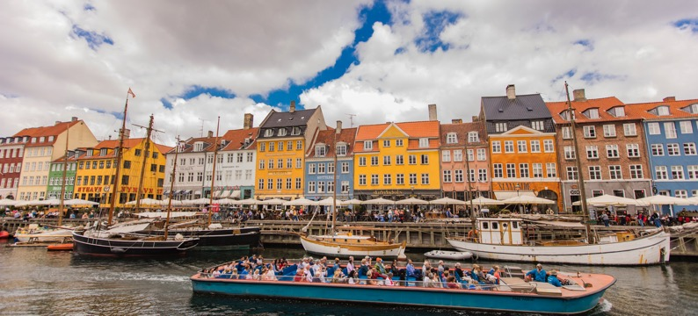
4.2.3. Denmark
In the case of Denmark, we selected one case study that shows how social innovation refers to the design and implementation of new solutions that imply conceptual, process, product, or organisational change, which ultimately aim to improve the welfare and wellbeing of individuals and communities. Cultural social innovation could therefore be expressed as using cultural methods and cultural organisations to drive social innovation.
The Turning Tables “Voice from the Block” initiative is a prime example of using cultural and creative methods to engage organisations in a programme that ultimately improves the social environment of a disadvantaged area and disadvantaged youths. It brings opportunities to engage young people in activities that build skills and confidence that will benefit them and their future.
"Voices from the Block" has been developed by Turning Tables Denmark in collaboration with Bikubenfonden, Brøndby Boligselskab, Boligselskabet Sjælland, Roskilde Festival and others, and is one of the 397 music projects around Denmark, which received part of the 28 million DKK which was distributed by the Art Foundation's Project Support Committee⁵⁶ for Music in 2020.
⁵⁶ https://www.kunst.dk/kulturlaboratorier-indtager-udsatte-boligomraader

Slide 60
The Art Foundation focuses on both getting art all over the country and giving all children and young people the opportunity to experience art. The project Voices from the Block is a long-term project that over the next four years (2019- 2022) will give young people in Roskilde and Brøndby Strand the opportunity to try their hand at music, film and photographic art guided by professional artists from Turning Tables.
The point of the initiative is not that the young people subsequently continue the work with just film, photography and music. The crucial thing is that through the experiences of working within the creative sector, they get the experience that they can learn new things, collaborate to achieve a goal and carry out a concrete project. Michael Bojesen, chairman of the board of the Kunstfonden and committee leader of the Project Support Committee for Music, points out, like Martin Højland and Michael Buch-Barnes, that the project strengthens the young people.
What stands as innovative in this initiative is that this project creates inclusion and new communities both professionally in the creative field, and socially between different groups of young people. Besides, it is interesting how colorful shipping containers are converted into professional studios where music, film and photography can be produced. These have been placed in nine different public housing areas around Denmark over the past two years. These areas are known to be socially disadvantaged residentially areas.
“Voices from the Block is based on the musicality of children and young people, and with a positive approach develops them as human beings. Through music, we can express our feelings such as love, pain and joy. That is why Stemmer fra Blokken is completely in line with other of the Kunstfonden's projects, where you get art to make a difference in socially disadvantaged residential areas”.⁵⁷ However, not only do the participants get to develop skills in music writing, singing, photography and filmmaking. They are also engaging with digital tools and platforms to create these artistic pieces. Digital skills are essential for young people to stay relevant in today’s job market and to be an active citizen, and so the programme offers a fun and engaging way for these participants to gain vital digital skills.
“
“We believe that it is good for people to be allowed to focus, immerse themselves and be present in processes where you translate thoughts into concrete creative works. Being allowed to convey one's thoughts and experience that it has a value for others is enormously rewarding, and makes the young people wiser about themselves and strengthens their self-esteem”
⁵⁷ https://www.kunst.dk/kulturlaboratorier-indtager-udsatte-boligomraader

Slide 61
Martin Højland, head of Turning Tables Denmark and one half of the music duo Den Sorte Skol. He adds that the young people, among other things, “get the opportunity to perform at Roskilde Festival and show their works in the Cinematheque and at the Copenhagen Photo Festival”.⁵⁸
For Martin Højland, it is absolutely central that foundations with a cultural focus and not just a social focus have supported the project. The children and young people who participate in "Voices from the Block" do not see it as a social offer, but as a place where they can explore their artistic abilities and creativity. And it is connected with another important point, namely that the project not only gives something to children and young people in public housing areas, but just as much that they give something to the culture of Denmark.
“These children and young people have stories, energy and creativity that you will not find anywhere else in Denmark. They write about everything from love to stigma, and we have been overwhelmed by how good they are, how much they have on heart, and the rest of us can only get richer by hearing their stories,”⁵⁹ says Martin Højland.
During this initiative, 200 children and young people have been able to unfold creatively, and after a few weeks, the shipping containers can leave the land again. These young people live in areas deemed to be more vulnerable in Denmark, with increased rates of no upper secondary education, higher rates of unemployment and higher rates of crimes. Thus, these young people often come from disadvantaged homes.
Behind the creation and insertion of the modified containers is the NGO Turning Tables Denmark. With support from the Statens Kunstfond and a large number of other foundations, it has become possible to launch a more long-term project called "Voices from the Block". The idea is to build permanent container studios in the middle of Æblehaven in Roskilde and in Hallingparken in Brøndby Strand. The studios will be open four days a week, with professional artists ready to guide children and young people in music, film and photography.
The building permit has just been approved in Brøndby Strand near Copenhagen. A large green area by the public housing area Hallingparken will therefore soon be occupied by shipping containers measuring 12x12 meters with space for both singing, film and photo studio, as well as exhibitions and concerts. The container studies are called cultural laboratories, and it is almost unique what is created in the laboratories.
“
“Not everyone is equally good at school, but perhaps they have some artistic talents that show through in their participation in the project. It can give them more confidence that they can take with them further in their lives”
⁵⁸ https://www.kunst.dk/kulturlaboratorier-indtager-udsatte-boligomraader
⁵⁹ https://www.kunst.dk/kulturlaboratorier-indtager-udsatte-boligomraader
⁶⁰ https://www.kunst.dk/kulturlaboratorier-indtager-udsatte-boligomraader

Slide 62

MSP-lights" by blah blah photos...blah blah blah is licensed under CC BY 2.0
says Michael Buch-Barne (Chairman of the board of Brøndby Boligselskab and city councillor for the Social Democrats).
Young people from the public housing area, these areas have higher rates of secondary school dropout and unemployment, thus, these young people tend to come from disadvantaged backgrounds. “Voices from the Block” give these young people the opportunity to explore their creative and cultural space, trying out the talents in singing, writing songs, playing instruments, creating songs, photography, videography and much more. The “cultural laboratories” are open 4 days a week, this enables the young people to engage in activities that foster creativity, communication and confidence.
One of those who knows Turning Tables particularly well is 18-year-old Yasin Amiri. Back in 2018, he had never been involved with music, and for that matter, had not even imagined that it was something he was going to do. At that time, Turning Tables was housed in the asylum centre Sandholm Camp, where Yasin Amiri was at language school. He could not quite see why he should try to produce music, but said yes, which resulted in him both writing a song and filming a music video. In the summer of 2019, Turning Tables dumped their shipping container down in Æblehaven in Roskilde, where Yasin Amiri lived. He spent every day in the culture lab producing music and videos. From there it was going strong, and he has now performed with Turning Tables at Roskilde Festival and Folkemødet, among others. Yasin Amiri has moved to Copenhagen and comes a couple of times a week to Turning Tables’ permanent location in Nørrebro.

Slide 63
“
“Music is a part of my everyday life now. And it's cool to come to Turning Tables in Nørrebro, where I either hang out with the other young people or make my own music”,
says Yasin Amiri, who has written songs in a genre in which the lyrics are based on his own life.⁶²
To encapsulate the key features of this initiative related to the topic of cultural social innovation, we should take into consideration that the locations in Denmark for the placement of “cultural laboratories” are selected carefully. These areas have a higher percentage of unemployment, low educational attainment and higher levels of crime. Therefore, the young people in these areas come from more disadvantaged backgrounds and would benefit the most from engaging in such cultural activities that would bolster their future prospects through the development of new skills in the creative sphere. In this case study, social innovation refers to the design and implementation of new solutions that imply conceptual, process, product, or organisational change, which ultimately aim to improve the welfare and wellbeing of individuals and communities. Cultural social innovation could therefore be expressed as using cultural methods and cultural organisations to drive social innovation. The digital aspect offered by this project is also central to the discussion of cultural social innovation within a 21st century context.
4.2.4. Ireland
Three cases are in the focus of Ireland in order to explore the topic of cultural social innovation, all of them pointing out to the importance of community development and its interconnection with the concept of culture which is expressed through different forms of art and/or social services.
⁶¹ https://www.kunst.dk/kulturlaboratorier-indtager-udsatte-boligomraader
⁶² Watch and listen to Yasin’s music video which takes place in Æblehaven in Roskilde, where Yasin lives. “Du Skriver” is filmed by 13-year-old Khabaat, who also worked with Turning Tables last autumn at Sjælsmark Asylcenter.

Slide 64
The Trinity Arts Centre (Castlerea, Co Roscommon)⁶³ provides local people with a much needed avenue to connect and engage in creative and cultural, social activity. Its aim is to provide a vibrant venue for music, arts, culture and heritage in west Roscommon. The Arts Centre had the objective of nurturing the rich culture of music, song, drama and dance that was already present in the area, but had no place to base itself to preserve and grow the rich and varied heritage of the area.
To understand the importance and necessity of this initiative, one needs to know that rural Ireland and small communities survive because of the pride of its people in their native place. Trinity Arts Centre is located in an old Church. This historic building has been beautifully restored to a high standard, using best conservation practices to preserve the fabric of the original structure. The most stunning stained glass windows provide a spectacle of colour and design. The original Queen Anne timber trusses have been exposed to open up the vaulted ceiling. Panels of cut stone and classic interior lighting help to create a beautiful venue with a unique atmosphere. To the rear of the building, they have built a modern extension with kitchen facilities and meeting rooms which can facilitate public and private functions.
This Arts Centre is an exemplary place to hold events that accommodate many people as well as smaller more inclusive events. The setting of the centre within an old church shows attendees how old institutions can be innovated to cater for changing local needs, without letting people forget the largesse of the previous building. The wider location of Roscommon and the North West is an area steeped in culture and pride in local creativity and artistic talent. Its existence is also important given that the area is considered to be less extensive in terms of economic and social development.
The initiative is made up of a group of local volunteers that consist of a great example of what community development means. Castlerea Community Arts Group (CCAG) is made up of a group of local people from Castlerea who have volunteered their time and energy over many years to make this project a reality. Hosting and organising of various shows and live performances from actors, musicians and local people all promoting arts, culture and social gathering. These events range from comedy nights to film showing to plays, all focused on local topics and people from the surrounding area.
CCAG have worked over the years to develop links with funding bodies e.g. Roscommon Integrated Development Company, various Government Departments, Roscommon Co Council. They continue to develop links that will help expand this project and sustain Trinity Arts into the future.
01
⁶³ Trinty Arts Castlerea – Your local entertainment hub (castlereaarts.com)

Slide 65
Books at One⁶⁴ is a collective of locally managed community bookshops. They offer a wide range of accessible and diverse literature and believe there is a book for everyone regardless of economic, educational or social status. They are a social enterprise, investing profits in fostering a love of reading for learning, pleasure and connection.
Books at One provides a place for local people to browse, sit down and take in the stories and knowledge in the pages of whatever book they choose. The bookshop has been designed so that it has the flexibility of the simple “black box” at the heart of many newer local theatres. A central island is on wheels, so it can be moved to make room for approximately 30 chairs for film-club nights, or gatherings too large for the room. Two book clubs meet in the shop each month. The self-service hot-drinks machine serves tea, coffee and hot chocolate for €1.50, or €1 for students. The shop stocks both new and donated second-hand books. Staff also order books for whoever wants them. Other activities like storytime for children take place weekly and at special occasions like halloween.
The bookshops act as social and creative hubs, offering a welcoming, comfortable space where people of all ages come together through a shared love of reading. By working collaboratively with local businesses, schools and voluntary organisations they give local people an opportunity and a reason to shop locally for books. They operate in areas of social disadvantage or rural isolation, providing employment, work experience and value added volunteering opportunities. Also, it operates a YouTube page to provide further access for people who better prefer visual or audio methods of learning,⁶⁵ and they have been featured on popular Irish podcast, ‘n Irishman Abroad’.⁶⁶
The innovative element is that it is the first community effort that was put back into the community that nobody has to pay for using it. Linking in with the local schools (two primaries and one secondary) and getting teachers’ support was part of the community remit. Competitions with children in schools were held to design shop materials (such as bookmarks). The bookshop provides a space for creative writing for secondary school students as well as a place for the many writers in the area to meet and network. The bookshop also hosts musical evenings, as well as readings by writers, both local and those with higher profiles: the award-winning local novelist, Mike McCormack, has come to read there. The success and popularity of Books at One initiatives has led to larger events such as book festivals which has brought tourism and new visitors to the area, helping other local businesses focused on culture in the process such as craft stores and music studios. Unlike many other rural villages and towns, Books at One has provided local people with a place to meet that is not a pub or sports hall, allowing for a deeper level of engagement between people.
02
⁶⁴ Community Book Shop | Louisburgh, Mayo | Letterfrack, Galway (booksatone.ie)
⁶⁵ Books At One - YouTube
⁶⁶ Podcasts - Books At One

Slide 66
Amal Women’s Association⁶⁷ was established to empower and respond to Muslim and non-Muslim women with cultural specific needs to facilitate and increase their participation and contribution to Irish society; to provide a culturally specific community-based service of information, guidance and supports to women both Muslim and non-Muslim, including a helpline and access to essential and emergency services; to support women both Muslim and non-Muslim through outreach programmes, cultural events, the provision of information and training and online communications, to address their specific needs in areas of leadership skills, group facilitation, community development, and policy development. Additionally, they provide many services for women and families that aid their integration into Irish society, including coffee mornings, courses in English, Driving Theory tests, Art Programs and talks about leadership and personal development. Besides, they have been active in raising funds for newly arrived refugees in Ireland.
This initiative focuses mostly on a social aspect of Irish society and is based in human rights and social justice, by providing cultural and religious rights to women and their families. Given the fact that muslim women and children in Ireland face huge barriers to accessing the services they need when they are in crisis, Amal’s activities address this need by supporting women in culturally appropriate ways to access the help they need, while educating service providers, so that they can have better lives for themselves and their community.
The innovative element of Amal’s work is that they contribute to the advancement of an Ireland where all -and particularly Muslim- women can access the services they need and fully participate in society, free from the threat of violence, poverty, racism, discrimination and stigma. They ensure the provision of culturally appropriate emergency accommodation for women and children in dangerous situations. They recognise the value of constructive dialogue and strategic partnerships in order to build strong foundations in the community.
03
To sum up, what is evident from the case studies in Ireland, is that cultural heritage, social needs and community development are interwoven and focal to explore the topic of cultural social innovation. Cultural stands because of engaging the local people into creative or/and socio-cultural activities; social stands because the way their work is evolving advances the concept of community development; and innovation stands because of the space and the way it functions one initiative, such as the revival of other local businesses, the use of different forms of art in order to empower the local community, the offer of services in order to allow self development to disadvantaged groups of people which all eventually can lead to strengthening the position of the beneficiaries inside the community.
⁶⁷ Home - Amal Women's Association (amalwomenirl.com); (16) Amal Women's Association | Facebook; AmalWomenAssociation (@AmalIRL) / Twitter

Slide 67

4.2.5. Italy
In the case of Italy, all three selected case studies put emphasis on the importance of community, and the need of a new approach of culture and cultural heritage seen from a bottom-up perspective.
01
The IAC Centro Arti Integrate - Societa Cooperativa di Produzione e Lavoro (IAC) works on theatre promotion and production. It was founded in 2010 by the artistic co-directors Nadia Casamassima and Andrea Santantonio, and it is driven by 3 values: (a) integration - believing in creating heterogenous cultural spaces; (b) experimentation - building innovative paths to create culture; and (c) collaboration - creating connections between cultural and social organisations. IAC is an arts, theatre and cultural centre located in Matera. The “headquarter” is a medium-sized studio located in the heart of the world heritage classified area of Matera. It is the perfect representation of what the IAC is aiming to accomplish, as it is an old building built in the traditional stones very characteristic of the city, that was reused and repurposed for cultural activities that hold space for social gatherings and innovative movements.
The target group of the activities pursued is mainly focused on young adults. Over the years, it has created workshops on training and theatre communication in collaboration with schools, associations, institutions, addressing its proposal to groups of people "fragile", disabled or groups that have difficulty in accessing cultural processes. The key activities of this association are its shows. Different shows are developed and presented aiming at an audience of children and adults. The shows are born from research paths and are the product of common expression through collective processes, both with actors and with theatre-goers. They narrate themes concerning contemporary reality, with particular reference to social implications.

Slide 68
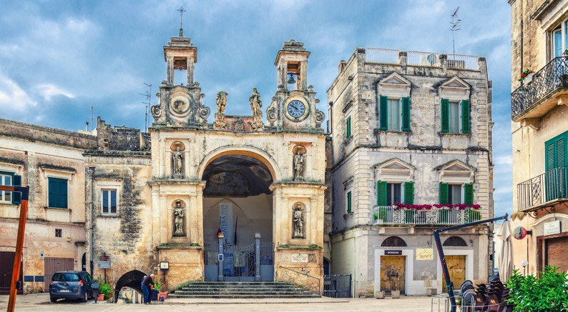
More specifically, such an indicative initiative is the “Nessuno Resti Fuori” (Nobody Stays Outside) project, a theatrical festival that aims at going beyond merely artistic purposes: its main objective is that of involving the entire city and its inhabitants. Nessuno Resti Fuori is realized by IAC since 2016 every year in a different neighbourhood of Matera. During the 10 days of activities, IAC in collaboration with several partners, organizes workshops, performances (musical, theatrical) and various shows. This festival is the occasion to experiment with the community and it develops a process of communication and creation.
Another indicative example is “BUILDING MY STAGE”, a training course in the field of theatre targeting young people, with the aim of enhancing and providing skills that can be used in the world of live shows. The training program is open to the guests of the host communities for unaccompanied foreign minors in the Basilicata region. During the course, the participants receive basic knowledge on scenic movement, acting and the technical disciplines of theatre lighting, music and scenography. With this action the aim is to give new impetus to that particular type of culture that for centuries has characterized our identity in universal terms: know-how.
What makes this case study different and worthwhile to include in this Guide is the fact that IAC is a space where people meet, relationships are built, distances are closed, and overall, it functions as a physical and emotional space where the community does not consume culture but generates it, with its visions and paths. According to this Guide’s context of what CSI means, this association and its initiatives are a perfect representation of cultural association trying to link the community with culture. The work of the IAC can truly be seen as social innovation as they aim to involve the community in the generation of new cultural elements, especially reaching out to groups with lower opportunities, such as the youth from out-centered districts and rural areas, bringing to them a chance to experiment with art and culture, be part of the movement, and create their own.

Slide 69
Voluntary Open Culture 2019 (VOC)⁶⁸ is an association born from the Fundazione Matera Basilicata 2019. The foundation was in charge of the development and organisation of cultural events taking place during the year of 2019, when Matera became the European Capital of Culture (ECOC). The volunteer association started with the foundation in 2017, two years before the ECOC events. Since the foundation is only created for the ECOC, and has a limited life span, the VOC association decided in early 2021 to become an official independent association which doesn’t have an ending date, and can therefore expand its projects to the entire community. It aims to reinforce the participation of local citizens in the support of culture (past and future) and cultural events. By doing so, the citizens would be able to see culture as a way to add value to their life. Some of the main objectives are:
to give access to creative and cultural events on a daily basis to locals;
to make culture part of the daily citizen life, beyond being a means for entertainment;
to connect people from different generations and backgrounds for them to exchange their perception of culture and create a common vision;
to make culture accessible in terms of diffusion, structure, location, and price; for instance, the volunteers who are helping with the organisation of events, are able to access the events for free or at a reduced price, with transposition and food included when necessary;
to help develop the well-being of the community by using culture as a tool to solve social problems;
to share the competences acquired through the volunteering actions with other volunteers from other countries.
One important feature to point out refers to the inexistence of criteria in order one to become a volunteer. It aspires to be inclusive and therefore anyone can join the association; it is also open to people with disabilities, in order to give opportunities and responsibilities to all. This approach also becomes its main innovative element as it attempts to create a movement of cultural volunteering (different from the common social volunteering) to emphasize on the sustainability of culture to create well-being. By focusing solely on culture, the association distinguishes itself from other forms of volunteer associations. It is also quite innovative for an association to give opportunities to the locals to have responsibilities and an impact on the cultural events organized in their community.
The association is 100% non-profit, while the volunteers can give a subscription fee of 10 euros per year, which contributes to the payment of the yearly insurance. There are no costs of management of the association, as every person of the association works on a volunteering basis. The costs linked to the cultural events, such as transportation and food, are covered by the organizing association (and not by VOC). Therefore, the costs are kept to almost none. Besides, VOC also accepts donations, but it does not ask for contributions from anyone. In addition, VOC aims to become more international by creating partnerships with various cultural associations from different countries (mainly cities which are going to be ECOC in the coming years).
02
⁶⁸ https://www.facebook.com/pages/category/Nonprofit-organisation/Volontari-Open-Culture-2019-543945579863072/
Insta: VOC2019

Slide 70
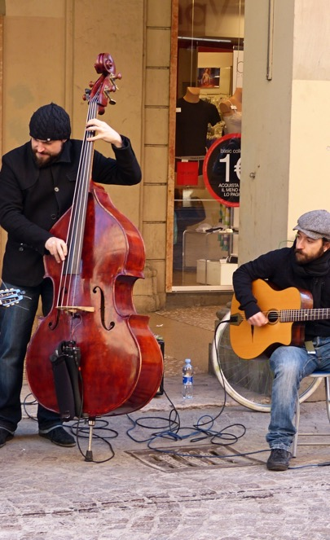
It is also interesting that the headquarter of VOC is based in a building used for different cultural events and open design training. Casino Paluda, is a big house that has been renovated to give it a cultural and social centre function. VOC does not have an office and does not pay a rent, but only uses the space for special gatherings of the volunteers, allowed by the municipality. The cultural events happen all over the city of Matera and the region of Basilicata. Occasionally, some events will take place in other regions or countries. The events are held in renovated parts that are classified as cultural heritage of the city, which emphasizes the connection of local culture with the community. Some events are also taking place in very remote rural places, to give access to the events to more marginalized communities, but also highlight the cultural elements found in those remote places.
The main actions of VOC are to support cultural events in the diffusion, promotion, and organisation of the events. Some of the events VOC has recently participated in are: Matera International Film Festival, Onyx Jazz Festival, Fucina Madre (regional promotion of artisans’ work) festival, Women in Fiction Literature Festival, and many more. During these events, the volunteers are not allowed to take over the responsibilities of employed staff, but only to support them in their work; such as helping with the distribution of flyers that promote the event, the welcoming of customers, checking of tickets, green pass, temperature (related to covid regulations), give information to guests, etc.
This association is a perfect example of a cultural association accomplishing social innovation through its activities and a bottom-up approach. The social cohesion created by involving the citizens in the organisations of the events, make the citizens leaders of the cultural direction they want their community to take. It is a very participative association, in which the cultural proposals come from the locals, and not from outside or higher decisional figures.

Slide 71
The Museo Laboratorio della Civilta Contadina Cultural Association⁶⁹ has been created by Donato Cascione. Donato manages the museum through ONLUS, a cultural association of which he is the director (created in 1998). The aim of the association is to provide a space where visitors can learn about the local past and traditions. Through this critical recovery of past reality, the museum aims to help the visitors better understand everyday life and develop the ability to develop projects for the future. The association is mostly focused on the impact on young people, and want to move beyond the generic and occasional relationship they have with museums by providing an educationally programmed environment, as a space equipped to work on processes of knowledge and training, and in which communication is a means of mediation between specialist knowledge and the daily work of education.
It targets visitors of all kinds, but mainly focuses on young people enrolled in school programmes. Those students are from all kinds of schools and all kinds of levels (from primary school to university). The museum provides a space for young people to learn in a more interactive and sensorial way about a part of their history. The offer of labs and workshops is an alternative to classic learning and is not only focused on learning a part of history, but also on developing soft skills (creativity, design thinking), as well as reinforcing the well-being of the young people by feeling a sense of belonging.
The museum charges for the visits as well as for the labs and workshops. Through those payments, the museum is able to be financially sustainable. Its main actions are to offer guided visits to discover a selection of ancient tools and artefacts that belonged to the farmers and land workers of Matera. In addition, besides being just a repository place, it also offers workshops to young people during which they can learn about the ancient trades and traditions of their community. The museum offers “lab” experiences and didactic itineraries to students of all school levels. Those workshops are organized between the schools and the museum, under the supervision of the teachers. The aims of those workshops are to foster knowledge and understanding of the local past traditions, people and environment. Through these labs, the museum wishes to promote a sense of belonging in the students and a sense of sharing of goods and values within the community. The labs also aim at stimulating design skills and creativity through research itineraries transitioning from perceptual to conceptual knowledge. The main labs offered by Donato are:
Lab “I paint and scratch tuff”
Clay workshop
Workshop on decoration of terracotta
Workshop on papier-mache
Sensory route
Lab “Me, little anthropologist”
Thematic teaching workshops
This association is a good example of a museum trying to link culture with the community and moving beyond its cultural purpose to have a social impact. Also, the museum is located in a part of the city that is classified as a world heritage site by UNESCO, therefore adding even more importance to the cultural and social aspect of the space. The director of the association is very dedicated to his community and truly believes in the power of cultural social innovation.
03
⁶⁸ https://museolaboratorio.it/en/info/
FB: museo laboratorio

Slide 72
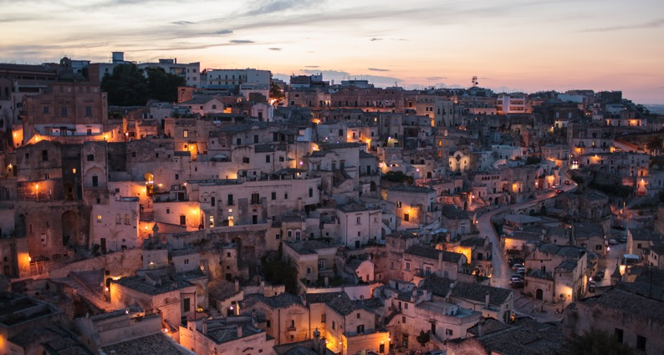
As a general finding to keep in mind from the case studies in Italy is the strong connection between social innovation and culture. It is notable that social innovation is linked with the power of community to generate new cultural elements and to strengthen its social implications towards vulnerable or marginalized groups of young people. One other important fact is that cultural social innovation is linked with the concepts of
a
culture and arts
(such as theater, music, poetry etc.),
cultural heritage (especially intangible heritage such as crafts, traditions and rituals) and
b
c
cultural volunteering as a participatory and bottom-up approach of acting.

Slide 73

4.2.6. The UK
As far as the UK is concerned, below, we present three case studies with an emphasis on the power of community and on the different forms of development and evolution for the community and its people.
01
Cook Creative helps creative organisations and social enterprises with business change and property development. The company was founded by David Cook, an award-winning social entrepreneur with 25 years’ experience leading cultural and social enterprises and a reputation for making things happen. Consultancy offering advice and pragmatic support to cultural and creative companies. Property development and business sustainability. A practice of doing not just talking. Cook Creative is not a traditional consultancy. Their view is that it’s not just about writing reports. It’s about providing practical, hands-on support, mentoring and guidance to help steer organisations through substantial change or the challenging process of capital development. The initiative targets the third sector and specifically cultural and creative companies.
⁷⁰ https://uk.linkedin.com/in/david-cook-6b102617

Slide 74
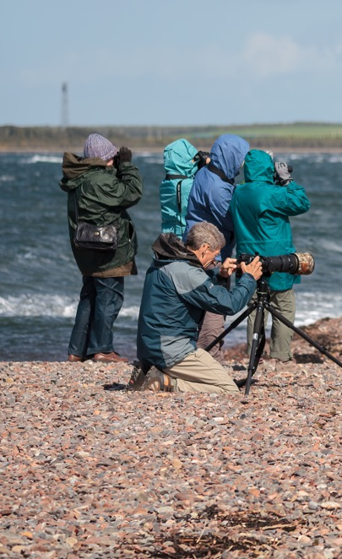
The innovative element is the Urban Garden Offices or Studios and on or off grid craft bothy. These are secluded sustainable buildings that can be set up and taken down just as quick. Through the impact of COVID-19, they saw a need for creativity and had several pod buildings set across the highlands of Scotland. Set in very remote areas of outstanding beauty, it is the perfect escape for artists to get away to the highlands while seeping in the views and creating their artistic vibe. The prefabricated construction system makes the installation straightforward, as well as minimizing the risk of weather interruptions and disturbance to the site. The well-insulated structures can be used year-round, and there are the options to introduce a wood-burning stove for added warmth. The cabins are designed to go completely off grid with a basic 12V electric system or opt for the creature comforts of 240V mains electric supply. They can also connect people to suppliers of amenities such as composting toilets, renewable energy services and water harvesting systems.
It is worthwhile to point out the fact that it provides a sustainable structure that can be on or off grid while connecting to nature and not disturbing it. With the impacts of COVID-19, a lot of people around the world have started to get more creative to pass times at home during lockdowns. This has seen several people possibly upskilling in a new area or just getting creative through painting, arts and crafts. Thus, we believe that this initiative could potentially help with the ideal of CSI. If there was a possible way within communities, especially rural areas of outstanding beauty where a similar initiative could take place. By identifying areas for this initiative to take place could help to spark creative flows within communities, thus helping to create a social enterprise with their work.

Slide 75
The New Arts Exchange (NAE)⁷¹ in Nottingham is a contemporary arts space, stimulating new perspectives on the value of diversity in art and society. NAE champion for embracing and engendering cultural diversity by leading and stimulating roles in the region to ensure that diversity resonates more widely at a national and international level. They have a commitment to informing and promoting the relationship between art and society:
Nurturing: To become a place where talent and creativity is nurtured.
Accessible: To make art and culture accessible to all.
Open and experimental: To be open and receptive to new ideas and opportunities.
Excellence: To recognise the value of excellence in all that we do.
NAE targets the whole community as it believe that everyone should have access to being creative through the arts. It offers a lively and varied community programme throughout the year, ranging from creative workshops that welcome people to their exhibitions, to longer projects that work intensively and closely with local groups, individuals and community organisations. It is constantly inspired by the different communities that surround it, including community groups from different faiths and heritage, and groups that come together due to shared interests or a common purpose. This means that the community programme is constantly shifting, adapting and responding to the needs and interests of the local and wider communities. Also, it is committed to co-creation, and working in partnership, offering spaces where individuals and community groups can collaborate with artists, taking part in high quality and inclusive arts opportunities. These projects support people to use their imagination, unlock their creativity, feel joy, learn new skills, develop confidence, and connect with other people. NAE can see how those arts can contribute towards social change, and how it can support people to create positive change within their local and global communities through creative activism. It ensures that wellbeing is integrated into every strand of the community programme. Compassion, Empathy, Kindness, Collaboration and Listening sit at the heart of everything.
New Art Exchange is an Arts Council England National Portfolio Organisation. Diversity, innovation, and excellence are at the heart of its work. Over 80,000 people visit annually and a further 100,000+ audiences are reached through its touring exhibitions and offsite work. Every year over 20 high quality exhibitions and over 90 events and performances are delivered. In a bid to embed innovation in policy and practice, it also provides specialist support for artists, creative enterprises, cultural leaders, and strategic partners in dedicated talent development programmes. The Real Creative Futures programme has supported over 240 pre-start-ups and launched 7 new creative businesses recently.
In addition, as times are ever changing, it developed through COVID-19 an online presence to stay connected with the communities and in turn it developed new workshops and programmes for all ages to continue development in uncertain times.
This case study is directly aimed at communities through arts and creative activities to help build initiatives within them that will help them drive a social change. It further aims to include all backgrounds of the community in order to bring them together and allow them to develop and grow their skills and creative activities within a shared safe space with like minded people. It is also important that NAE helps the local communities to drive creation with an economical aspect to help them thrive.
02
⁷¹ http://www.nae.org.uk/; https://www.facebook.com/newartexchange

Slide 76
City Takeovers - Inter Cultural Events⁷² aims to work with communities; create an ecosystem; and tackle social issues creatively with a business-oriented mind. The key activity is to bring together artists and local communities to work together and collaborate in the right way to express their culture and in turn teaching their cultural values through arts and performance.
Its focus is on disadvantaged young people and young people with disabilities as well as their communities. The main goal is that they look at the skills and attributes that already exist within communities. Instead of trying to see the gaps and discover who and when, they can connect them to the right people in the right places so that their assets and skills can grow with time. This approach eventually led to the concept of city takeovers. It started out as a conversation around culture and what it meant to connect and collaborate. Through this process, it became evident the power within the community of being a stranger to be able to support that community and to create new networks where one would invite public and private sector, local, national and international artists to work and collaborate with that community.
This process normally lasts about 1-2 years, and ends with a festival to celebrate, leaving behind a legacy of a sustainable network which was built around the assets and skills of the community. Understanding the mission, the initiative develops the communities to carry on long after the 2-year programme. UKYA City Takeover: Nottingham 2019 brought together over 250 national and international artists from 25 countries. Organized by the national charity UK Young Artists (UKYA), who champion the next generation of creativity by supporting and developing the careers of artists aged 18-30. Nottingham has a rich cultural heritage and a tradition of artist-led projects including the influential Midland Group (1943-1987), which was committed to the presentation of ‘progressive and experimental visual arts in Nottingham’. The opening of Dance4, an international centre for dance development, and two public galleries, Nottingham Contemporary and New Art Exchange, has helped cement Nottingham as a centre for the arts. More recently The New Midland Group, comprising three independent artist studios, Backlit, One Thoresby Street and Primary, have built on the legacy of the Midland Group, seeking to further develop the promotion of visual arts and artists.
This case study is a great example of how a community has the power and becomes the focus of one’s activities. It is important to highlight that this initiative has been successful in several countries and places, and it dives right into the local people and their traditions. It helps communities to express themselves through arts and performance and generally helps communities to thrive. In addition, it advocates for the need within less of communities to improve by engaging with their already their talents. It helps individuals on a journey of self-discovery and gives them the tools needed to develop and grow to better themselves and their surrounding communities.
03
Given the above-presented case studies, the emphasis was put on the importance of community development through cultural aspects that allow for social change. The direct target of all communities within a local area, the driving of individual cultures to thrive for the better, the building-up of relationships across different cultures, the creation of safe creative spaces for the local communities, the awareness within local communities to advocate for social change are the key highlighted features for the UK context.
⁷² https://www.bjcem.org/ukya-city-takeover-the-event/

Slide 77
05
The Cultural Social Innovation Framework

Slide 78
05
THE CULTURAL SOCIAL INNOVATION FRAMEWORK
BASED ON THE FINDINGS OF THIS RESEARCH, AND AS MENTIONED IN CHAPTER 3 (METHODOLOGY), WE REFLECTED ON THREE EXISTING COMPETENCE FRAMEWORKS RELEASED BY THE EUROPEAN UNION:
EntreComp,
DigComp, and
LifeComp
These helped to developed the Cultural Social Innovation (CSI) Framework, with a special focus on adults and cultural organisations.
Nowadays, social and cultural empowerment are deeply related to digital empowerment. However, to be a competent “cultural social innovator” means so much more than being an experienced digital (re)user. Therefore, instead of being a pure digital competence framework, the CSI Framework focuses on a number of skills that are not directly or strictly digital, but are related to a wider scope of personal development and entrepreneurship.
The CSI framework aims at creating an ongoing learning process, structured in a way that it can become a kind of platform for the creation of learning materials on digital education and culture-based social innovation culture for adults and cultural organisations. Also, this framework does not distinguish learners from trainers, because, in the context of non-formal education, the roles of the trainer and the learner are overlapping — they both can learn from and train each other.
However, it is not designed and doesn’t intend to function as an extensive resource that covers the entire discussion about digital and culture-based social innovation. Hence, it can be combined with other additional resources in various ways, and it can be used as a starting point and tool in order to introduce potential target groups to digital and culture-based social innovation, to frame other discussions, or create a working pattern for other existing initiatives.

Slide 79

Overall, the CSI Framework aims at promoting:
Knowledge and skills for adults who have been most affected by the challenges posed by the COVID-19 pandemic;
Culture-based social innovation culture, since community engagement is first and foremost a shared effort by different stakeholders and groups, and creativity and collaboration are fundamental when it comes to finding and proposing solutions to existing social problems and challenges.

Slide 80

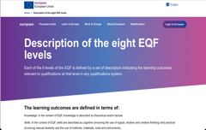
5.1. The structure and content of the framework
Based on the competence frameworks mentioned above, we categorised the main competences needed to be a confident cultural social innovator in the following 4 thematic areas:
01
identifying challenges and opportunities,
finding resources,
communicating and collaborating, and
taking action
02
03
04
In addition, we accompanied each competence with a hint which is a short description of the competence adults are expected to cultivate, followed by the related descriptors. Based on the descriptor levels, as mentioned in the European Qualification Framework (see descriptor page of EQF), the CSI Framework mainly focuses on Level 1, Level 2 and partially
Level 3 of knowledge, skills, responsibility and autonomy. As such, the purpose of this framework is to introduce, guide and change the mindset in relation to culture-based social innovation. The competencies are divided according to the identified thematic areas, and of course are not meant to be exhaustive or conclusive.
CLICK TO VIEW

Slide 81
Thematic Area | Competences | Hints | Descriptors
1 Identifying challenges and opportunities | 1.1 Flexibility | Ability to manage transitions and uncertainty, and to face challenges. | Readiness to review opinions and courses of action in the face of new evidence. Understanding and adopting new ideas, approaches, tools, and actions in response to changing contexts. Managing transitions in personal life, social participation, work and learning pathways, while making conscious choices and setting goals.
 | 1.2 Growth mindset | Belief in one’s and other’s potential to consciously learn and progress. | Awareness of and confidence in one’s own and others’ abilities to learn, improve and achieve with work and dedication. Understanding that learning is a lifelong process that requires openness, curiosity and determination. Reflecting on other people’s feedback as well as on successful and unsuccessful experiences to continue developing one’s potential.
01

Slide 82
Thematic Area | Competences | Hints | Descriptors
1 Identifying challenges and opportunities | 1.3 Spotting opportunities | Use your imagination to identify opportunities for creating value | Identify and seize opportunities to create value by exploring the social, cultural and economic landscape. Identify needs and challenges that need to be met Establish new connections and bring together scattered elements of the landscape to create opportunities to create value.
 | 1.4 Vision, ideas and creativity | Work towards your vision of the future and develop creative and purposeful ideas | Recognize the potential an idea has for creating value, and visualize future scenarios turning ideas into action. Think of several ideas and opportunities to create value, including better solutions to existing and new challenges. Explore innovative approaches.
01

Slide 83
Thematic Area | Competences | Hints | Descriptors
2 Finding resources | 2.1 Information and data literacy | Browsing, searching, filtering, evaluating, and managing data, information and digital content | Articulate information needs, search for data, information and content in digital environments, access and navigate between them, create and update personal search strategies. Analyse, compare, and critically evaluate the credibility and reliability of sources; interpret the data, information and digital content. Organise, store, retrieve and structurally process data, information and content in digital environments.
 | 2.2 Critical thinking | Assessment of information and arguments to support reasoned conclusions and develop innovative solutions. | Awareness of potential biases in the data and one’s personal limitations, while collecting valid, and reliable information and ideas from diverse and reputable sources. Comparing, analysing, assessing and synthesising data, information, ideas, and media messages in order to draw logical conclusions. Developing creative ideas, synthesising and combining concepts and information from different sources in view of solving problems.
02

Slide 84
Thematic Area | Competences | Hints | Descriptors
2 Finding resources | 2.3 Financial and economic literacy | Develop financial and economic know-how | Estimate the cost of turning an idea into a value-creating activity. Plan, put in place and evaluate financial decisions over time. Manage financing to make sure a value-creative activity can last over the long term.
 | 2.4 Self-awareness, self-efficacy, motivation and perseverance | Believe in yourself, keep developing, stay focused and don’t give up | Identify your individual and group strengths and weaknesses, and believe in your ability to influence the course of events, despite uncertainty, setbacks and temporary failures. Be determined to turn ideas into action. Be patient and resilient; keep trying to achieve your individual and group aims.
02

Slide 85
Thematic Area | Competences | Hints | Descriptors
3 Communicating and Collaborating | 3.1 Communication | Use of relevant communication strategies, domain-specific codes and tools, depending on the context and content. | Awareness of the need for a variety of communication strategies, language registers, and tools that are adapted to context and content. Understanding and managing interactions and conversations in different socio-cultural contexts and domain-specific situations. Listening to others and engaging in conversations with confidence, assertiveness, clarity and reciprocity, both in personal and social contexts.
 | 3.2 Use of digital technologies | Interacting, sharing, and collaborating through digital technologies. | Create and manage one or multiple digital identities and protect one’s own reputation. Interact through a variety of digital technologies and understand appropriate digital communication means for given context. Share data, information and digital context with others through appropriate digital technologies. Use digital tools and techniques for collaborative purposes, and for co-creation of data, resources and knowledge. Know about referencing and attribution practises. Be aware of netiquette.
03

Slide 86
Thematic Area | Competences | Hints | Descriptors
3 Communicating and Collaborating | 3.3 Mobilize others | Inspire, entuse, and get other on board | Inspire and enthuse relevant stakeholders. Get the support needed to achieve valuable outcomes. Demonstrate effective persuasion, negotiation and leadership.
 | 3.4 Collaboration | Engagement in group activity and teamwork acknowledging and respecting others. | Intention to contribute to the common good and awareness that others may have different cultural affiliations, backgrounds, beliefs, values, opinions, or personal circumstances. Understanding the importance of trust, respect of human dignity and equality, coping with conflicts and negotiating disagreements to build and sustain fair and respectful relationships. Fair sharing of tasks, resources and responsibility within a group taking into account its specific aim; eliciting the expression of different views and adopting a systemic approach.
03

Slide 87
Thematic Area | Competences | Hints | Descriptors
4 Taking action | 4.1 Take the initiative | Go for it | Initiate processes that create value. Take up challenges. Act and work independently to achieve goals, stick to intentions, and carry out planned tasks.
 | 4.2 Plan, manage, and work with others | Organize, make decisions, network and team up | Set long- medium- short-term goals, define priorities and action plans. Make decisions dealing with uncertainty, ambiguity and risk. Work together and cooperate with others to develop ideas and turn them into action.
 | 4.3 Digital content creation | Developing, integrating and re-elaborating digital content Programming Copyright and licenses | Create, edit, improve digital content in different formats, and integrate it into an existing body of knowledge to create new original content and knowledge. To plan and develop a sequence of understandable instructions for a computing system to solve a given problem or perform a specific task. Understand how copyright and licenses apply to data, digital information and content.
04

Slide 88
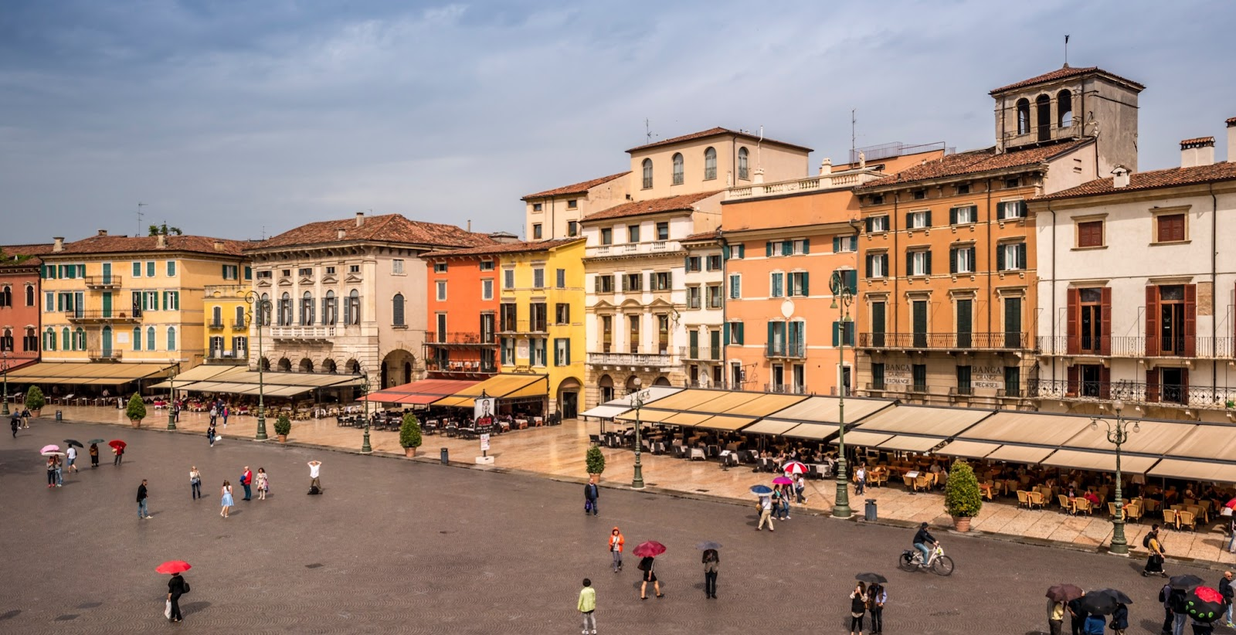
Thematic Area | Competences | Hints | Descriptors
4 Taking action | 4.4 Problem solving using digital technologies | Identifying needs and creatively using digital technologies to provide technological responses | Assess needs and Identify, evaluate, select and use digital tools and possible technological responses to solve them. Adjust and customise digital environments to personal needs. Use digital tools and technologies to create knowledge, and innovate processes and products; engage in cognitive processing to understand and resolve conceptual problems and problem situations in digital environments.
04
Piazza Brà in the historic centre of Verona" by Sorin Popovich is licensed under CC BY-NC-SA 2.0

Slide 89
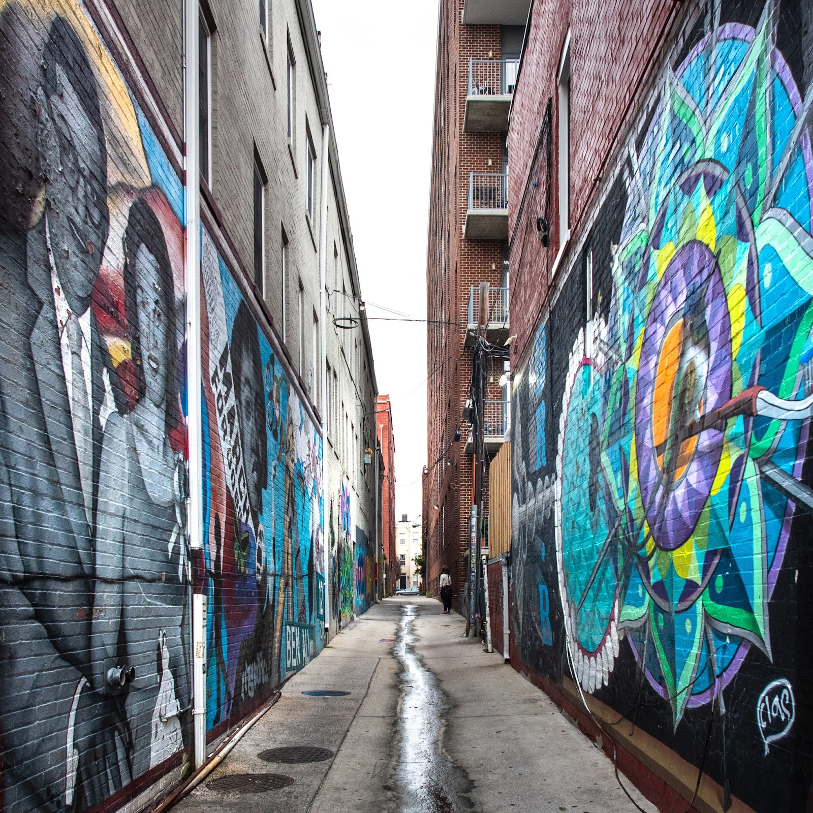
5.2. Uses of the Comparative Competencies Table for CSI
The Comparative Competencies Table for CSI aims to be used as a pathway for the designing, organisation and implementation of culture-based social innovation projects by adults, adult educators and arts and cultural organisations in the context of the CSI EU project and beyond. It is a step-by-step pattern, which can also be used as a self-assessment tool, so that the targeted groups and organisations can be realistic as far as their project goals and influence in society are concerned. Of course, when using this table, one doesn’t have to go through all the aspects of all the steps but can pick and choose only the ones that are more suitable for the specific aims and needs of the project in which she/he works.
The Comparative Competencies Table for CSI can also be reused by different organisations, even schools and educational institutions, which would like to focus on service-learning or culture-based education. It can also be useful to those who simply want to have more knowledge on cultural social innovation methods and tools, and a steady understanding of how these can be reused. Hence, it greatly supports out-of-the-box thinking, and the finding of creative solutions to existing social problems. Last but not least, the table can be adapted to different areas, objectives and target groups, according to the theme and the desirable impact. This is the power of Cultural Social Innovation — to provide creative tools which can be reused and revised to reform reality and to support the strategies of different groups. The role of adult educators and arts and cultural organisations in this process is just to empower adults and local communities to take initiatives.
u street alleys" by Der Berzerker is licensed under CC BY 2.0

Slide 90


Annex 1: The project partners
Dungannon Enterprise Centre - Property & Business Advice County Tyrone
01
Dungannon Enterprise Centre's (DEC) primary aim is “to strengthen and grow our economy by encouraging economic development and supporting entrepreneurs to create and grow competitive, profitable and wealth generating enterprises”. We help energize their community through capacity and competency programmes, provision of social innovation space, and specific measures to reach those most challenged in the community to maximize their potential. As Adult educators, DEC's work also extends to the professionalization of the third sector economy in supporting voluntary and community groups, NGOs and non-profit organisations including charities, cooperatives, towards sustainable business growth through creative methods.
Home - European E-Learning Institute (euei.dk)
02
European E-learning Institute (EUEI) specializes in digital pedagogy and inclusive learning approaches; be that through the creation of powerful online platforms, immersive blended educational environments or the provision of resources and tools to create truly valuable learning experiences. EUEI was founded on the concept of 'continuing education'; a post-secondary education programme that provides further enrichment to learners in a wide range of sectors, covering topics that are professional and/or personal. As an organisation, EUEI places tremendous worth on the informal and flexible nature of continuing education and crafting flexible, online learning courses for those wishing to improve themselves and stay ahead in their careers and in business. Building inclusive and resilient communities is also a key goal of the organisation.

Slide 91


home - Inter Alia (interaliaproject.com)
03
Inter Alia is a civic action organisation aiming at the creation of an inclusive and active European civil society through educating and engaging young adults. Inter Alia's central aim is raising the awareness of the EU citizens on available channels for acting, participating and shaping Europe. Therefore, it has a strong multicultural outlook, and seeks to educate young people on the significance of openness, inclusiveness, respect, tolerance, equality, extroversion, diversity and interconnectedness. Inter Alia believes that the sustainable construction of a stronger Europe can only be achieved with the active participation of the people, both young and adults. As an organisation working closely with hundreds of young adults per year, Inter Alia provides upskilling in areas of civic engagement, inclusion and employability for the development of European civil society. Inter Alia uses a range of pedagogical techniques to engage with these often-disadvantaged young people, so that they can grow stronger by turning their attention to the world and cultivating their knowledge, skills and confidence to be active and engaged EU citizens.
Consorzio Materahub - Cultural and Creative Industries
04
Materahub is a consortium that promotes entrepreneurship and development training for and within the creative and cultural sector. Committed to a future in which culture and the arts thrive as part of the economy and society, it brings together individuals and businesses to help them grow, encourage the creation of new job opportunities and sustainable development through a process of coaching, training and business development. Its consortium of four companies and its core staff of 20 cover all aspects of creative and cultural business development, and includes a Vocational Education and Training company, a consulting firm, an international certification body and a social cooperative managing cultural heritage and creative activities in the UNESCO site of Matera. The Materahub core staff are varied in their roles ranging from project coordination to communication and administration, and bring over 20 years’ experience in adult education initiatives, having supported skills development in all types of organisations of all shapes and sizes, as well as coordinating and participating in EU projects supported by EACEA, DG Enterprise and Industry and national agencies around Europe.

Slide 92



Momentum - Business Consulting and Marketing Services (momentumconsulting.ie)
05
Momentum is one of Ireland’s leading creative economy and cluster development specialists. It supports Creative Sector Entrepreneurs and Communities by providing them with up-to-date training to enable them to adopt and adapt to emerging online business models, paving the way for future business growth. With an intimate knowledge of the creative entrepreneurship landscape, it focuses on developing progressive learning programmes and platforms for education, creative communities and practitioners, with special focus on developing support structures for socio economically challenged regions.
Youth Bridges Budapest
06
Youth Bridges Budapest was founded with the mission of helping young people better deal with challenges of the 21st century. It believes it is essential to create and nurture values among young adults which enable them to contribute to and adapt to the rapidly changing world. Over recent years, Youth Bridges has grown into a thriving centre for direct services to young people, as well as strategic leadership and technical support from start to finish for large scale youth projects, including train-the-trainer and innovation projects that improve the quality of youth work and nonformal youth education across Europe.

Slide 93
2: Countries overview - Similarities and Differences
Common and different elements per country | Denmark | Greece | Hungary | Ireland | Italy | UK
existing definition of cultural social innovation | no | no | no | no | yes (Institute Luigi Sturzo): Generating social innovation with culture means moving from a concept of audience expansion, the so-called audience development, to a concept of creative participation of groups of the population in the process of cultural production | yes (askinglot): The Social and Cultural Innovation SWG monitors and assesses the implementation of existing Social Sciences and Humanities RIs, disseminates and shares best practices of Social Sciences and Humanities RIs, and highlights and improves the potential applications in multi-disciplinary RIs.
existing definition of social innovation | no / depending on context and time: the concept is often being used as a buzzword in many different contexts with very different meanings. It has been seen used synonymously with e.g. companies’ social responsibility (CSR), voluntary work, new welfare technology and even new forms of social interaction in the workplace | yes: The production of products and the provision of services, which aim at meeting social needs, reconciling production and consumption, harmonizing supply and demand and the formation of a new type of social relations based on collectivity and parity and not on competition | no uniformly accepted definition / Most often, social innovation is interpreted as follows: “Social innovation provides new or novel answers to a community’s problems with the goal of increasing the well-being of the community | no / depending on context and time | no (borrowed from foreign literature) | yes: Social innovation refers to the design and implementation of new solutions that imply conceptual, process, product, or organisational change, which ultimately aim to improve the welfare and wellbeing of individuals and communities.

Slide 94
Common and different elements per country | Denmark | Greece | Hungary | Ireland | Italy | UK
Culture and Social Innovation | not seen in the same context | linked | initiatives from the field of culture and creativity are less considered as social innovations | not seen in the same context | n/a | the vibrant start-up culture of London provides a unique source of inspiration for cultural institutions to innovate and explore new areas.
Cultural Heritage and Social Innovation | linked | linked: the National Documentation Center, whose institutional role (as a digital and physical infrastructure of national scope) is to collect, organize and preserve the entire Greek scientific, research and cultural output (content and data) disseminating it at both national and global level, considers important to take into consideration that Europeana Innovation Agenda highlights research and innovation priorities for the cultural heritage sector | Cultural Social Innovation is linked with the (slow) tourism, especially cultural heritage tourism, thematic and cultural routes. | highly linked: Dublin was selected as the city for the first Platform on the Future of Cultural Heritage as it has been particularly active in the field of cultural heritage and social innovation. There is a link between the terms 'heritage and cultural innovation' and 'social and cultural change'. These imply that the term has a link to our shared past and traditions (heritage) while also focusing on the potential of the future (change). | highly linked: social innovation in the cultural sector is often represented by cultural heritage initiatives | n/a

Slide 95
Common and different elements per country | Denmark | Greece | Hungary | Ireland | Italy | UK
Science, Technology and innovation | n/a | linked: in the context of the implementation of the European Structural and Investment Funds 2014-2020 in the field of Research, Technology and Innovation, the General Secretariat for Research & Technology of the Ministry of Education, Research & Religions in collaboration with the Ministry of Culture announced the special action of Open Innovation in Culture focusing on "Culture, Cultural Heritage, Science and Technology” | n/a | n/a | n/a | Cultural entrepreneurship represents the meeting point of culture, technology and entrepreneurship. It is fueled by collaboration between different industries, including the cultural and creative industries, technology and financial services

Slide 96
Common and different elements per country | Denmark | Greece | Hungary | Ireland | Italy | UK
Social Entrepreneurship and innovation | linked: mostly social innovation is addressed through social entrepreneurship targeting primarily disadvantaged groups of people | linked: Social innovation and social economy in Greece are relatively new concepts mainly associated with what is known as ‘Solidarity Economy’. One of the Municipalities in the periphery of Attica (Athens), the Municipality of Kallithea has created a network of social innovation whose main focus was on supporting unemployed people in founding social enterprises. To our understanding, this could be considered as an implication that from a bottom-up approach social innovation is linked with social enterprises. | social economy, social entrepreneurship, social services and social innovation are not clearly distinguished. Social innovations and social entrepreneurship are strongly interlinked, having a complementary and an important role to play in tackling major societal challenges | linked: the National Social Enterprise Policy for Ireland acknowledges Social Entrepreneurship and Innovation as small but important parts of the Irish enterprise ecosystem, and that it is highly reliant on private donation, voluntary assistance and the aid of organisation such as Social Innovation Fund Ireland. This policy highlights the different interpretations of social innovation between countries and cultures; however, it does not attempt to combine or mention the link between social innovation and culture. | linked: engaged in maximization of human and environmental well-being. | linked: cultural organisations engage and co-opt entrepreneurial formats and structures.

Slide 97
Common and different elements per country | Denmark | Greece | Hungary | Ireland | Italy | UK
Digital transformation and cultural innovation | n/a | highly linked: during 2007-2013, there have been developments driven by programmes in the context of the "Digital Convergence" Operational Programme of the Ministry of Economy , part of the 4th Community Support Framework programme in the area of Information Society Technologies (2007-2013) | n/a | n/a | n/a | n/a
Strategy for social Innovation | It has ben adopted a law since Jnaaury 2015 where social entrepreises can register if they meet 5 specific criteria (social purpose; significant commercial activity; Independence of public authorities; Inclusive and responsible governance; social management of profits) | Bible of Digital Transformation 2020-2025 by the Ministry of Digital Governance | currently no focused framework, legislative and funding background for the development, systemic management of the social innovation environment and the addition of social issues to economic and technological innovation processes. | supportive policies: 1. Creative Ireland 2017-2022; 2. Ireland 2040; 3. Investing in our Culture, Language and Heritage 2018-2027; 4. National Social Enterprise Policy 2019-2022 | complicated political system divided I regions, yet it is considered animportant policy tool to respond to new needs and socio-economic changes | Yes

Slide 98
Common and different elements per country | Denmark | Greece | Hungary | Ireland | Italy | UK
Tax incentives for innovation | the Danish Government set aside 42.6 million DKK for social enterprises in the years 2012-2015 | Call 31 of the programme, launched in late 2011, amounts to ca. 60 million EUR and supports projects related to the digitisation of cultural heritage, popular and contemporary culture assets, their enrichment, access through web services and mobile devices apps, and integration within a unified metadata repository. | The institutional form of social enterprise in Hungary exists under the label of social cooperative defined by the 141/2006. (VI. 29.) governmental decree on social cooperatives. Social cooperatives often provide employment opportunities for the long-term unemployed or groups who are disadvantaged on socio-economic grounds. | n/a | yes but at territorial and regional level | Yes
Innovation seen as the expression of movements that create a more open and socially acceptable society and culture. | initiatives: 1. to create larger, stronger partnerships between social enterprises and traditional businesses; 2. that support muncipalities to work with social entreprises in their local area with the overall purpose of creating more jobs for disadvantaged people | n/a | SozialMarie is a prize for social innovation awarded to 15 outstanding projects every year since 2005. It has been the first prize for social innovation in Europe | Yes (Marriage Equality Referendum and Abortion Referendum) | n/a | n/a

Slide 99
Common and different elements per country | Denmark | Greece | Hungary | Ireland | Italy | UK
Research and policy papers in national regional or local level | TEPSIE, a large-scale European research project, led by the Danish Technological Institute and The Young Foundation set out to formulate a common definition of social innovation based on an extensive global literature study. The research team arrived at the following definition: “Social innovations are new solutions (products, services, models, markets, processes etc.) that simultaneously meet a social need (more effectively than existing solutions) and lead to new or improved capabilities and relationships and better use of assets and resources. In other words, social innovations are both good for society and enhance society’s capacity to act.” (Young Foundation, 2012). | little research only in greek language | yes: Boros, Julianna - Kozma, Tamás - Márkus, Edina ed. (2021) Community Building and Social Innovation, Region and Education 13 / Nagy, Katalin (2021) Social Innovation Opportunities in Tourism - in Hungarian: Társadalmi innovációs lehetőségek a turizmusban, Multidiszciplináris tudományok, 11. kötet. (2021) 2sz. pp. 360-371 | There is the policy of National Social Entreprise that goes along with the social innovation. As for the cultural innovation, there is The Culture 2025 policy focuses on the link between culture and creativity, supporting the link between creative practice and cultural participation; but the term 'social innovation' is not mentioned once in the policy, indicating that Culture and Social innovation aren't seen in the same context. | very central | very central

Slide 100
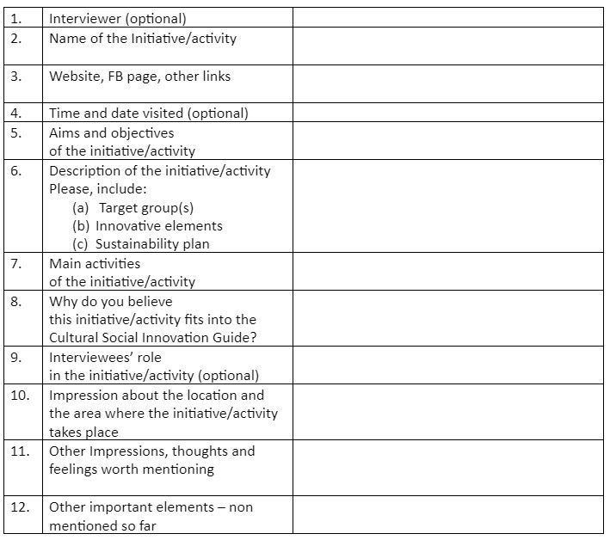
3: Desk and field research template
Information about the state of the art concerning Cultural Social Innovation in your country - an overview
Please, provide a short description, not more than 1 page in order to get the overall framework within the specific country.
Definition(s) – Is there a definition for social innovation? Is there a definition for cultural social innovation? Since when?
Supporting policies (if any)
Legislation and taxation (if any)
Ongoing movements (if any)
a. Academic research (review of journals and publications) – if available and accessible
b. Online research (policy and practice documents) – please, add latest developments in the country, especially information about policy papers and adopted policies
Best practices and case studies concerning the term Cultural Social Innovation in your country
In order to use a unified approach, we propose the following table, and a face-to-face interview with the organization/company/entity holding the good practice. Please, add min 3 per country.
Bibliography and resources

Slide 101
Resources
List of References
“141/2006. (Vi. 29.) Korm. Rendelet a Szociális Szövetkezetekről.” LexPraxis, http://www.jogiportal.hu/index.php?id=sj6hle501xvc9o8c2&state=20110901&menu=view.
“About Us.” UCCU Alapítvány, 14 Sept. 2020,
https://www.uccualapitvany.hu/en/.
“Alkotótér: Bázis: Klub.” Auróra,
https://auroraonline.hu/.
Bach, Per. “Denmark.” Social Entrerprise Sector Snapshot Around The Baltic Sea: Stakeholders , Education, Impact Analysis,
http://socialinnovation.lv/wp-content/uploads/2015/02/makets-ENG-26.02-15.40-IO1-final.pdf.
“Biennale of Western Balkans.” BoWB,
https://bowb.org/about-bowb/.
“Care Principles of Indigenous Data Governance.” Global Indigenous Data Alliance,
https://www.gida-global.org/care.
COM(2007) 242. “Document L29019.” European Agenda for Culture in a Globalising World, European Commission, 2007,
https://eur-lex.europa.eu/legal-content/EN/TXT/?uri=LEGISSUM%3Al29019.
Commission, European. “A New European Agenda for Culture - SWD(2018) 267 Final.” Culture and Creativity, 2018,
https://ec.europa.eu/culture/document/new-european-agenda-culture-swd2018-267-final.
Commission, European. “CELEX1, Green Paper - Unlocking the Potential of Cultural and Creative Industries, /* COM/2010/0183 Final */.” Photo of Publications Office of the European Union, Publications Office of the European Union, 27 Apr. 2010,
https://op.europa.eu/en/publication-detail/-/publication/1cb6f484-074b-4913-87b3-344ccf020eef/language-en.
Commission, European. “Strategic Framework for the EU's Cultural Policy.” Culture and Creativity, https://ec.europa.eu/culture/policies/strategic-framework-for-the-eus-cultural-policy.
“Community Book Shop: Louisburgh, Mayo: Letterfrack, Galway.” Books At One, 13 Aug. 2021, https://www.booksatone.ie/.

Slide 102
“Current Cultural Affairs Greece.” Compendium of Cultural Policies & Trends, https://www.culturalpolicies.net/database/search-by-country/country-profile/category/?id=16&g1=2.
“Current Cultural Affairs, Greece.” Compendium of Cultural Policies & Trends, https://www.culturalpolicies.net/database/search-by-country/country-profile/category/?id=16&g1=2.
Danish Technological Institute. Social Innovation in Local Government - Experiences from Denmark. https://www.dti.dk/_/media/65461_Social%20Innovation%20in%20Local%20Government.pdf.
“Description of the National Laboratories.” National Research, Development and Innovation Office, https://nkfih.gov.hu/for-the-applicants/innovation-ecosystem/national-laboratories-programme/laboratories.
“Egyedi Hímzett Termékek Matyóföldről.” Matyodesign,
https://matyodesign.hu/.
European Expert Network on Culture and Audiovisual (EENCA). “Platforms on the Future of Cultural Heritage: A Problem Solving Approach. Report on the Dublin Platform on 'Heritage and Social Innovation'.” Eenca, http://www.eenca.com/index.cfm/publications/report-on-the-dublin-platform-on-heritage-and-social-innovation/.
The European Pillar of Social Rights Action Plan,
https://op.europa.eu/webpub/empl/european-pillar-of-social-rights/en/.
European Structural and Investment Funds. Καινοτομία. 2009, https://www.espa.gr/el/Pages/DictionaryFS.aspx.
“Europeana Innovation Agenda.” Europeana Pro, 18 Dec. 2018,
https://pro.europeana.eu/page/europeana-innovation-agenda?&page_posts=1.
“Europe's Top Heritage Awards Honour 21 Exemplary Achievements from 15 Countries.” Europa Nostra, 15 Mar. 2021,
https://www.europanostra.org/europes-top-heritage-awards-honour-21-exemplary-achievements-from-15-countries/;
“Fair Principles.” GO FAIR, 21 Jan. 2022,
https://www.go-fair.org/fair-principles/.
GSTI. “Προδημοσίευση Ειδικής Δράσης Ανοικτής Καινοτομίας Στον Πολιτισμό. Πολιτισμός, Πολιτιστική Κληρονομιά, Επιστήμη Και Τεχνολογία.” GSRT.gr, GGEK, 2016, http://www.gsrt.gr/central.aspx?sId=124I458I1163I646I509701&olID=777&neID=589&neTa=1_21286&ncID=0&neHC=0&tbid=0&lrID=2&oldUIID=aI777I0I119I428I1089I0I3&actionID=load&JScript=1.
Guide to Social Innovation - European Commission.
https://ec.europa.eu/regional_policy/sources/docgener/presenta/social_innovation/social_innovation_2013.pdf
HAARDER, BERTEL. “Vedtaget Af Folketinget Ved 3. Behandling Den 11. Juni 2014 Forslag Til Lov Om Registrerede Socialøkonomiske Virksomheder.” Forslag - Folketingstidende.dk , 2014, https://www.folketingstidende.dk/RIpdf/samling/20131/lovforslag/L143/20131_L143_som_fremsat.pdf.
Home - Amal Women's Association.
https://www.amalwomenirl.com/.

Slide 103
Hulgård, Lars. “Social Economy and Social Enterprise: An Emerging Alternative to Mainstream Market Economy?” Roskilde University Research Portal, Routledge,
https://forskning.ruc.dk/en/publications/social%C3%B8konomi-og-social-virksomhed-et-alternativ-under-udvikling-.
“Innovate UK.” GOV.UK,
https://www.gov.uk/government/organisations/innovate-uk.
“Innovazione Sociale.” Ministro per La Pubblica Amministrazione, 7 May 2021,
https://www.funzionepubblica.gov.it/innovazione-sociale.
John René Keller Lauritzen. “Social Innovation in Denmark.” SIC, https://www.siceurope.eu/countries/denmark.
Khabaat, director. Yasin - Du Skriver. YouTube, YouTube, 17 June 2019, https://www.youtube.com/watch?list=PLu33_yzEN622rGCB7UIsfwJ4yMZNQjQ8I&v=leowUGqGeAE .
Accessed 28 Mar. 2022.
“Kulturlaboratorier Indtager Udsatte Boligområder.” Kunst.dk,
https://www.kunst.dk/kulturlaboratorier-indtager-udsatte-boligomraader.
“The Museum: Story & Info – Museo Laboratorio Della Civiltà Contadina Di Matera.” Museo Laboratorio Della CiviltContadina Di Matera,
https://museolaboratorio.it/en/info/.
Nabeela Ahmed, et al. “How Is EU Employment Policy Driving Social Innovation? .” Documents.pub, 2017, https://documents.pub/document/how-is-eu-employment-policy-driving-social-innovation-eu-funded-social-innovations.html.
Nasioulas, Ioannis. “Social Innovation in Greece .” SIC, 2015, https://www.siceurope.eu/countries/greece/profile.
Nesta. “About Us.” Nesta,
https://www.nesta.org.uk/.
New Art Exchange,
http://www.nae.org.uk/.
“Our Work in Innovation Policy.” Nesta,
https://www.nesta.org.uk/innovation-policy/our-work-innovation-policy/.
“Research and Innovation Culture.” UKRI,
https://www.ukri.org/our-work/supporting-healthy-research-and-innovation-culture/research-and-innovation-culture/.
Rialtas na Heireann. Government of Ireland, Department of Rural and Community Development. “National Social Enterprise Policy for Ireland 2019-2022.” Gov.ie, 2019,
https://assets.gov.ie/19332/2fae274a44904593abba864427718a46.pdf.
“Social Innovation.” OECD,
https://www.oecd.org/regional/leed/social-innovation.htm.
“Social Innovation.” Social Innovation - Employment, Social Affairs & Inclusion - European Commission, https://ec.europa.eu/social/main.jsp?catId=1022.

Slide 104
“Social Sciences and Cultural Innovation |.” Dublin City University, https://www.dcu.ie/courses/undergraduate/salis/social-sciences-and-cultural-innovation.
Sophie Reynolds, et al. Social Innovation Policy in Europe: Where next? - Nesta. 2017, https://www.nesta.org.uk/documents/603/social_innovation_policy_in_europe_-_where_next.pdf.
“Sozialmarie Prize for Social Innovation.” SozialMarie,
https://www.sozialmarie.org/.
“Sxedia Home.” Sxedia , 12 Oct. 2020,
https://shediahome.gr/?lang=en.
TEKNOLOGISK INSTITUT. “ The Theoretical, Empirical and Policy Foundations for Building Social Innovation in Europe.” CORDIS EU Research Results, European Commission, 2014, https://cordis.europa.eu/project/id/290771/reporting.
“Trinity Arts Centre.” Trinty Arts Castlerea,
http://www.castlereaarts.com/.
“A Társadalmi Innovációs Nemzeti Laboratórium (TINLAB) Projekt Keretében Díjmentes Kurzust Indít Az ELTE Innovációs Központ.” Www.elte.hu,
https://www.elte.hu/innovacio/tinlab.
“UCCU Budapest Roma Városi Séták.” UCCU BUDAPEST, 14 May 2020,
https://www.uccusetak.hu/en/.
“UCCU Roma Informal Educational Foundation.” European Heritage Awards / Europa Nostra Awards, https://www.europeanheritageawards.eu/winners/uccu-roma-informal-educational-foundation/.
“UK Launches International Social Investment Strategy.” UK Launches International Social Investment Strategy | British Council,
https://www.britishcouncil.org/society/social-enterprise/news-events/news-uk-international-social-investment-strategy.
“Ukya City Takeover: The Event.” BJCEM,
https://www.bjcem.org/ukya-city-takeover-the-event/.
“Victoria Square Project: Evolving Social Sculpture: Athina.” VSP, 14 Mar. 1970, https://www.victoriasquareproject.gr/.
Ελληνική Δημοκρατία, Υπουργείο Ψηφιακής Διακυβέρνησης. “Βίβλος Ψηφιακού Μετασχηματισμού 2020-2025.” Govgr, 2021,
https://digitalstrategy.gov.gr/vivlos_pdf.
“Ν. 4430/2016 (ΦΕΚ 205/Α` 31.10.2016).” ΕΛΙΝΥΑΕ, 2016,
https://www.elinyae.gr/ethniki-nomothesia/n-44302016-fek-205a-31102016.
“Ψηφιακή Καινοτομία.” Βίβλος Ψηφιακού Μετασχηματισμού 2020-2025, https://digitalstrategy.gov.gr/sectors/digital_innovation.

Slide 105

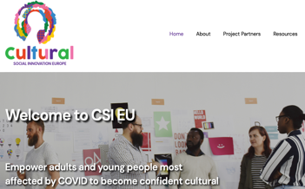

Follow our journey
www.csi-project.eu

